Slide 1
Distance Distribution with Simulated BSD

Slide 2
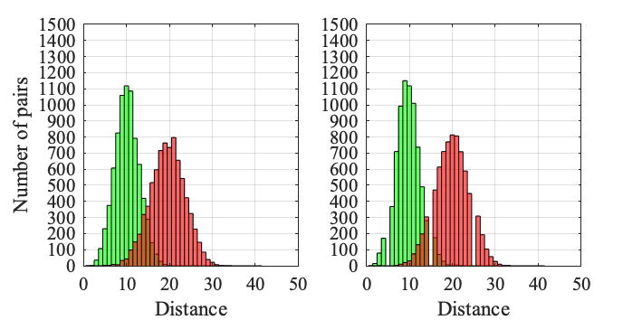
Route length = 10, Accuracy = 75%
Union Square (12%)
Wall Street (19%)

Slide 3
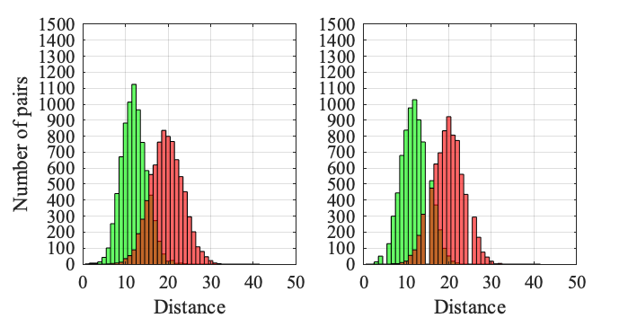
Route length = 10, Accuracy = 70%
Union Square (3.6%)
Wall Street (5.4%)

Slide 4
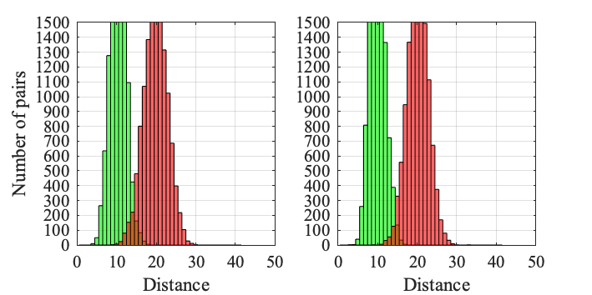
Route length = 20, Accuracy = 75%
Union Square (41.4%)
Wall Street (66%)

Slide 5
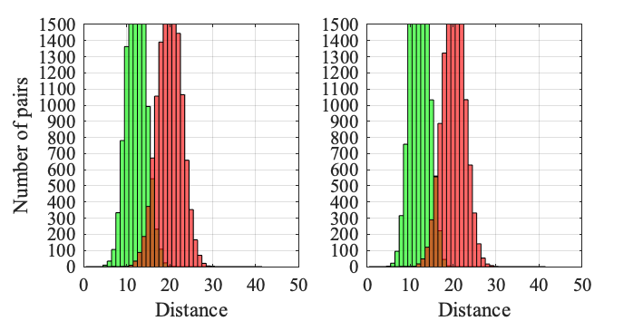
Route length = 20, Accuracy = 70%
Union Square (19.4%)
Wall Street (26.4%)

Slide 6
Distance Distribution with Real BSD

Slide 7
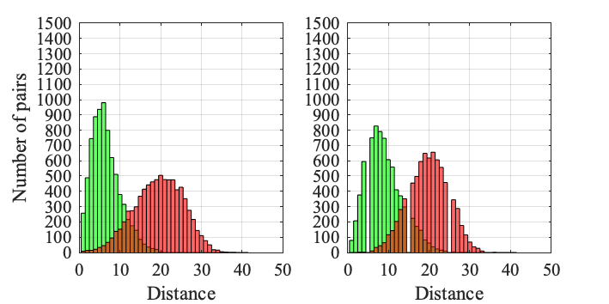
Route length = 10
Union Square (7.8%)
Wall Street (8.4%)

Slide 8
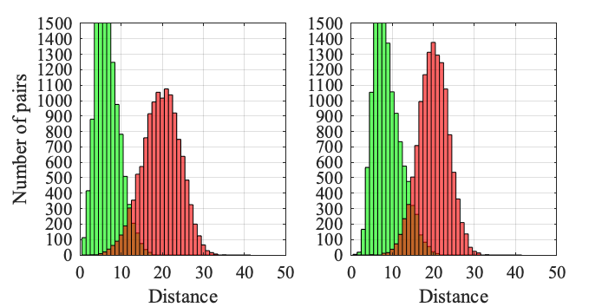
Route length = 20
Union Square (26.2%)
Wall Street (37.4%)

Slide 9
Dataset Statisctic for Training, Validation and Testing

Slide 10
Training Set
Num of junctions | Num of non_junctions | Num of gaps | Num of non_gaps
63404 | 124130 | 88272 | 99262
187534 |  | 187534
375068
Validation Set (Hudson River)
Num of junctions | Num of non_junctions | Num of gaps | Num of non_gaps
2989 | 7011 | 3372 | 6628
10000 |  | 10000
20000

Slide 11
Testing Set (Wall Street)
Num of junctions | Num of non_junctions | Num of gaps | Num of non_gaps
4260 | 5740 | 4023 | 5977
10000 |  | 10000
20000
Testing Set (Union Square)
Num of junctions | Num of non_junctions | Num of gaps | Num of non_gaps
3156 | 6844 | 4297 | 5703
10000 |  | 10000
20000

Slide 12
Hudson River

Slide 13
Junction | Accuracy | precision | recall | specificity | F1 | loss
Resnet18_accuracy | 83.8% | 79.4% | 61.7% | 93.2% | 69.4 | 0.3911
Resnet18_precision | 83.7% | 82.2% | 58.2% | 94.6% | 68.1 | 0.3897
Resnet18_recall | 78.2% | 60.8% | 75.9% | 79.1% | 67.5 | 1.0985
Resnet18_F1 | 82.7% | 72.8% | 67.4% | 89.3% | 70 | 0.4226
Resnet18_loss | 83.7% | 82.2% | 58.2% | 94.6% | 68.1 | 0.3897

Slide 14
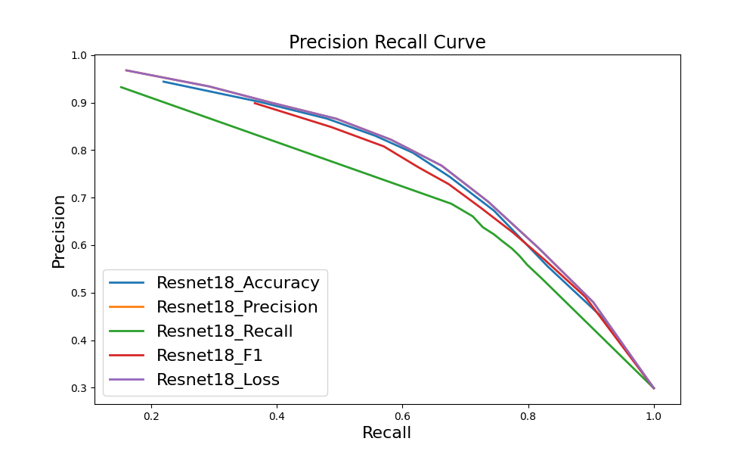

Slide 15
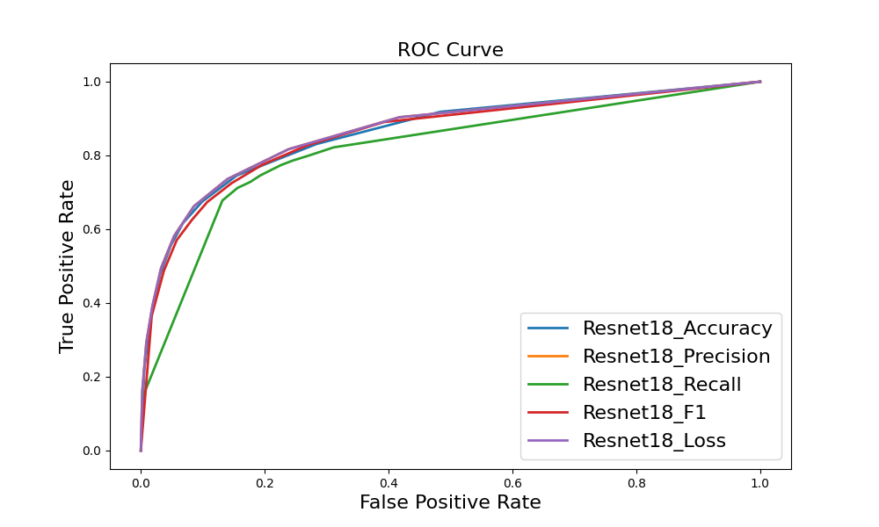

Slide 16
Junction ghmc | Accuracy | precision | recall | specificity | F1 | loss
Resnet18_accuracy | 82.1% | 74.8% | 60.5% | 91.3% | 66.9 | 0.8138
Resnet18_precision | 80.9% | 84.3% | 44.3% | 96.5% | 58.1 | 0.6627
Resnet18_recall | 72.8% | 53.1% | 79.3% | 70.1% | 63.6 | 0.5092
Resnet18_F1 | 79.4% | 64.2% | 70.8% | 83.1% | 67.3 | 1.2639
Resnet18_loss | 74.3% | 56.3% | 62.1% | 79.5% | 59.1 | 0.4993

Slide 17
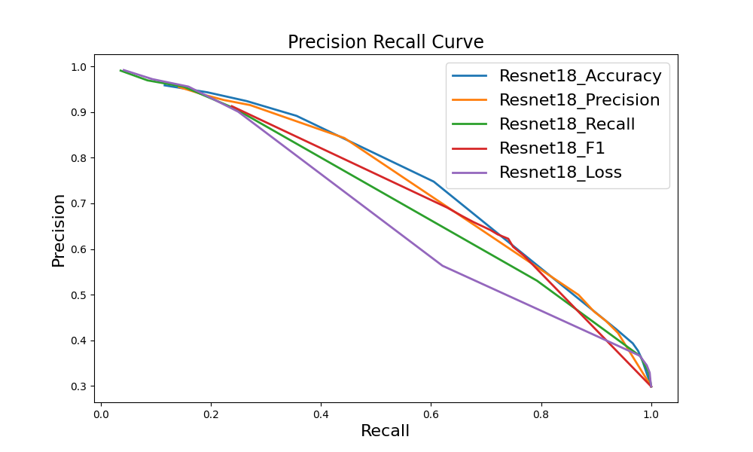

Slide 18
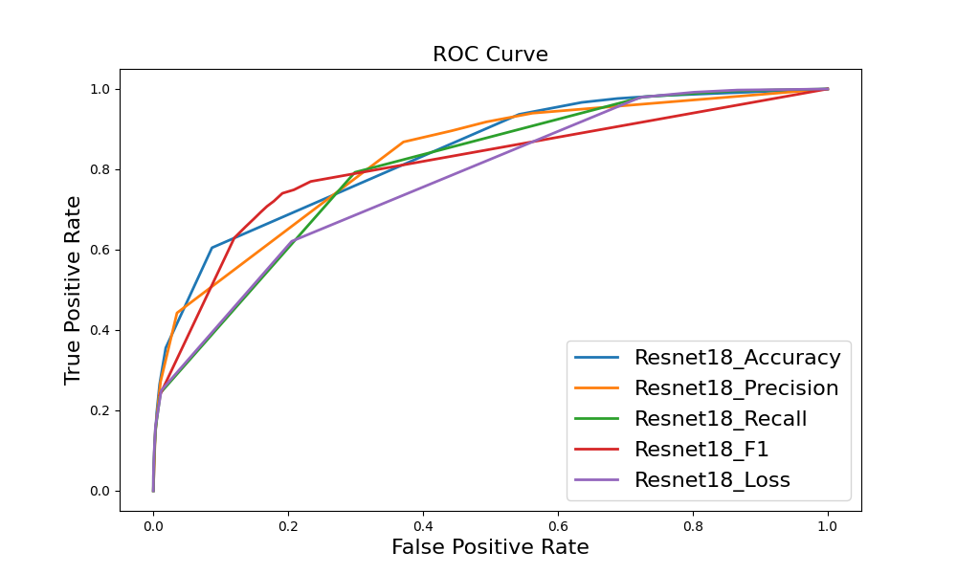

Slide 19
Gap | Accuracy | precision | recall | specificity | F1 | loss
Resnet18_accuracy | 84.2% | 78.1% | 73.9% | 89.5% | 76 | 0.4246
Resnet18_precision | 83.6% | 80.7% | 67.3% | 91.8% | 73.4 | 0.4074
Resnet18_recall | 84.2% | 74.5% | 80.9% | 85.9% | 77.6 | 0.4023
Resnet18_F1 | 84.2% | 74.5% | 80.9% | 85.9% | 77.6 | 0.4023
Resnet18_loss | 84.2% | 74.5% | 80.9% | 85.9% | 77.6 | 0.4023

Slide 20
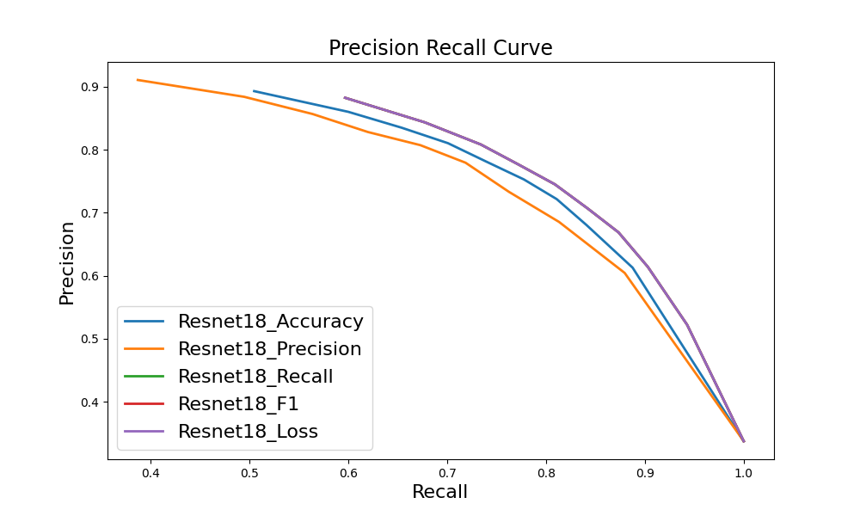

Slide 21
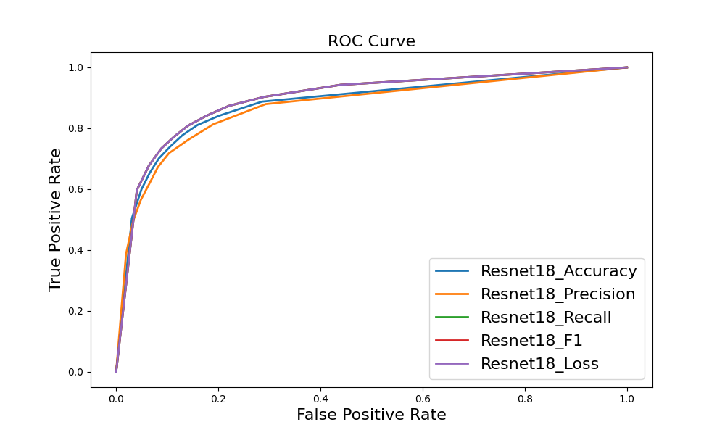

Slide 22
Gap ghmc | Accuracy | precision | recall | specificity | F1 | loss
Resnet18_accuracy | 73.7% | 79.1% | 69% | 90.8% | 73.7 | 1.0063
Resnet18_precision | 71.5% | 79.2% | 65.2% | 91.3% | 71.5 | 0.8318
Resnet18_recall | 73.5% | 67.3% | 81% | 79.9% | 73.5 | 0.9043
Resnet18_F1 | 74.7% | 69.8% | 80.3% | 82.3% | 74.7 | 0.9152
Resnet18_loss | 79.4% | 77.1% | 55.2% | 91.7% | 64.4 | 0.5495

Slide 23
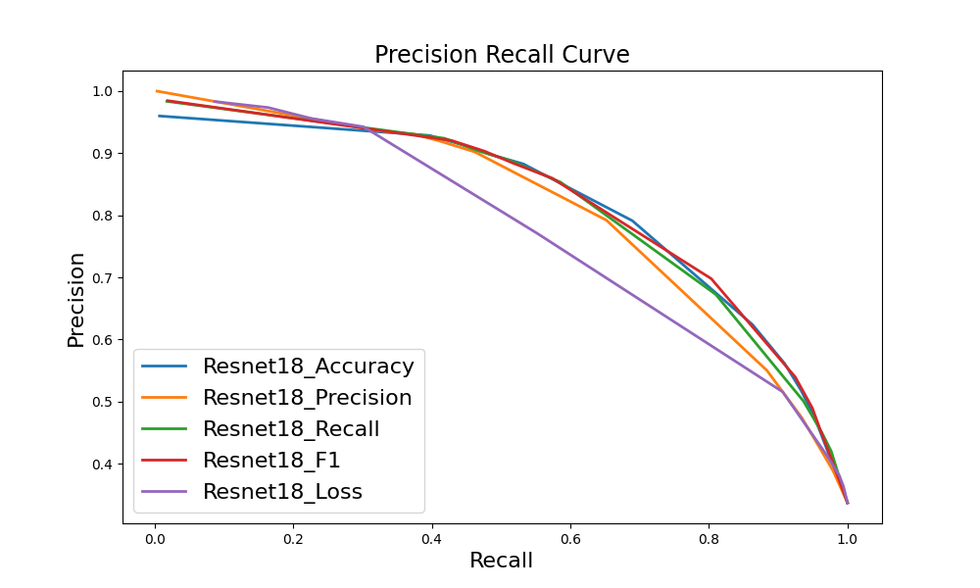

Slide 24
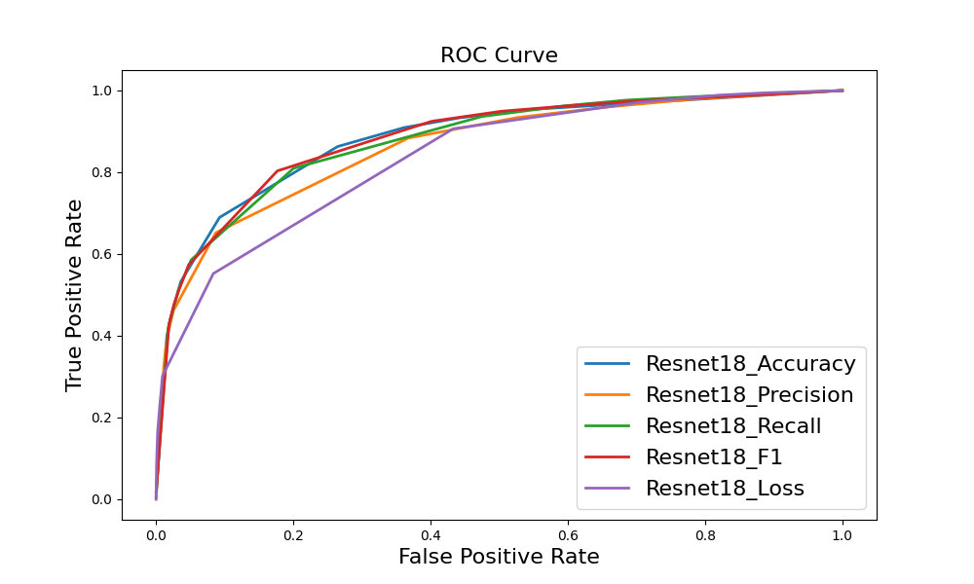

Slide 25
Wall Street

Slide 26
Junction | Accuracy | precision | recall | specificity | F1 | loss
Resnet18_accuracy | 73.2% | 82.8% | 46.9% | 92.8% | 59.9 | 0.5575
Resnet18_precision | 72.3% | 86.8% | 41.2% | 95.3% | 55.9 | 0.5903
Resnet18_recall | 71.6% | 67.3% | 65.1% | 76.5% | 66.2 | 1.3463
Resnet18_F1 | 73.1% | 77.7% | 51.5% | 89% | 62 | 0.5974
Resnet18_loss | 72.3% | 86.8% | 41.2% | 95.3% | 55.9 | 0.5903

Slide 27
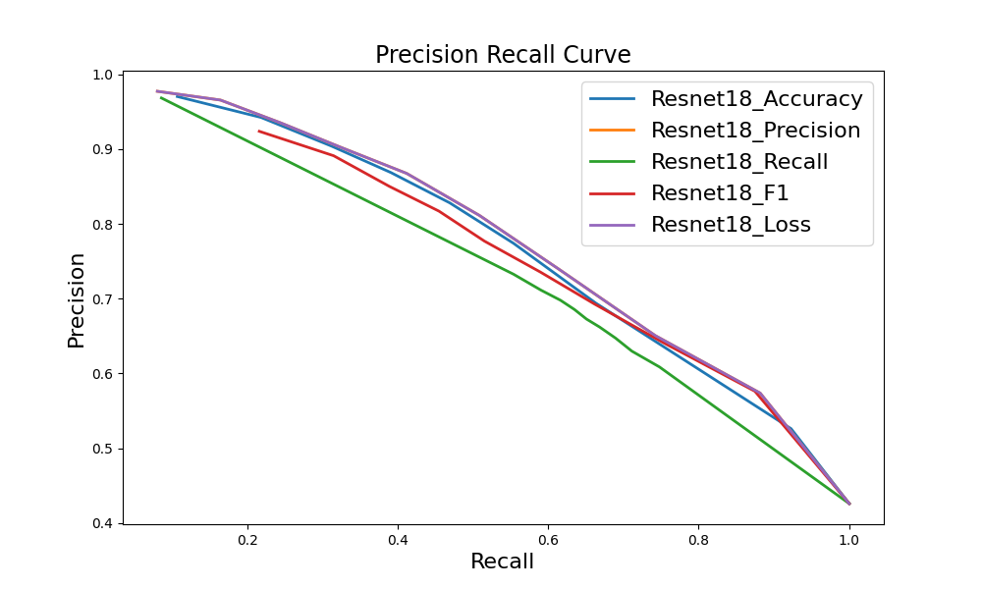

Slide 28
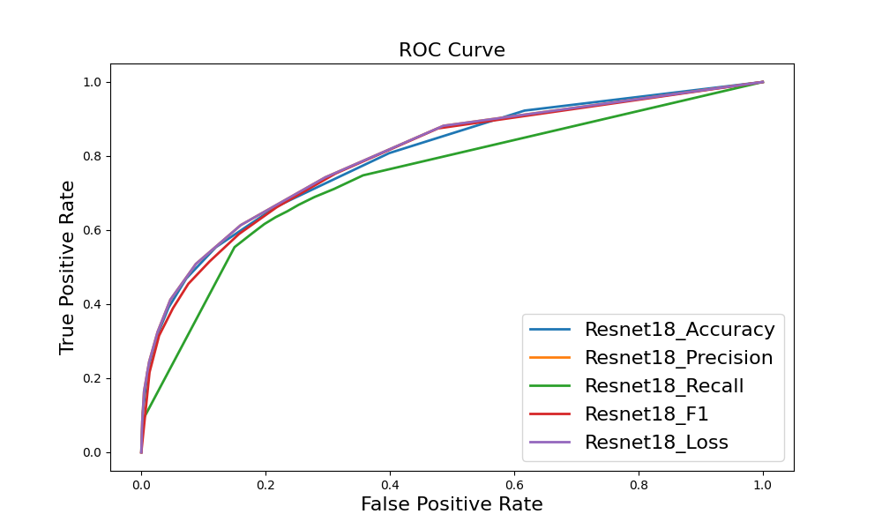

Slide 29
Junction ghmc | Accuracy | precision | recall | specificity | F1 | loss
Resnet18_accuracy | 72.4% | 78.7% | 48.3% | 90.3% | 59.9 | 0.8267
Resnet18_precision | 69.1% | 87.2% | 32.2% | 96.5% | 47 | 0.6982
Resnet18_recall | 68.8% | 62.1% | 68.7% | 68.9% | 65.2 | 0.5053
Resnet18_F1 | 71.5% | 69.1% | 59.7% | 80.2% | 64.1 | 1.1880
Resnet18_loss | 69.4% | 69.2% | 50.7% | 83.2% | 58.5 | 0.5351

Slide 30
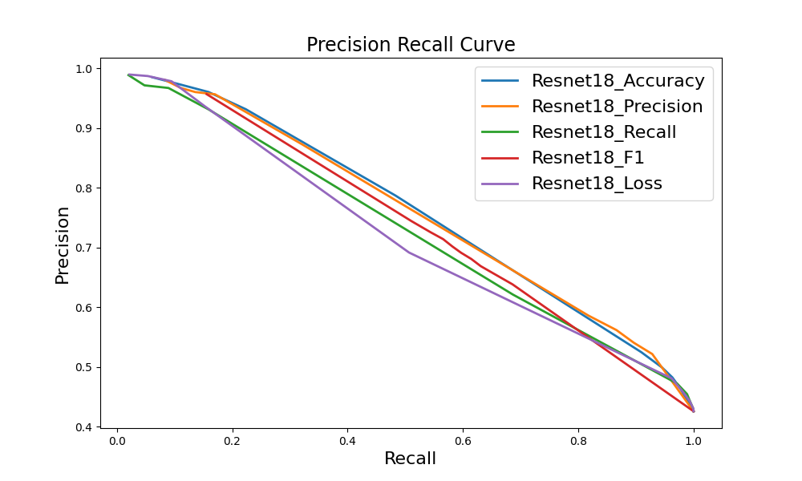

Slide 31
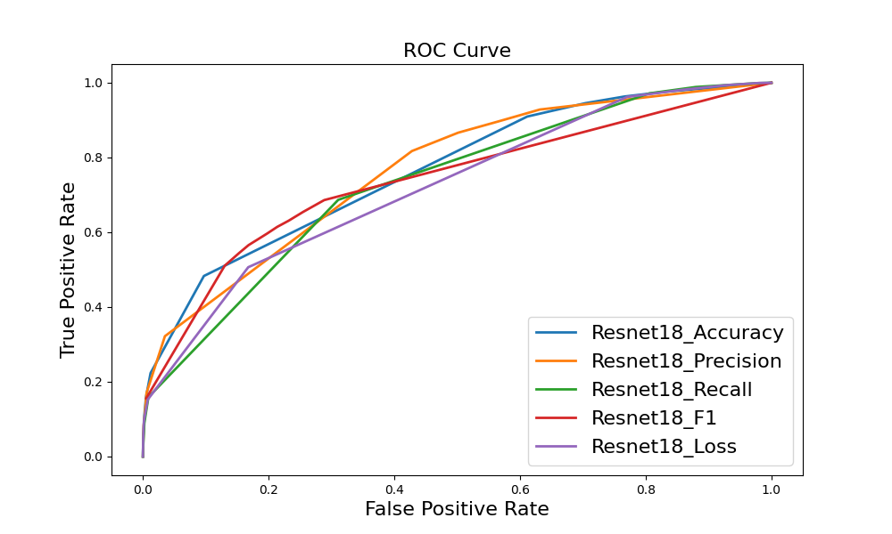

Slide 32
Gap | Accuracy | precision | recall | specificity | F1 | loss
Resnet18_accuracy | 79% | 74.3% | 73.2% | 83% | 73.7 | 0.4974
Resnet18_precision | 77.1% | 76% | 62.8% | 86.7% | 68.8 | 0.502
Resnet18_recall | 81.3% | 75.1% | 80.1% | 82.2% | 77.5 | 0.4655
Resnet18_F1 | 81.3% | 75.1% | 80.1% | 82.2% | 77.5 | 0.4655
Resnet18_loss | 81.3% | 75.1% | 80.1% | 82.2% | 77.5 | 0.4655

Slide 33
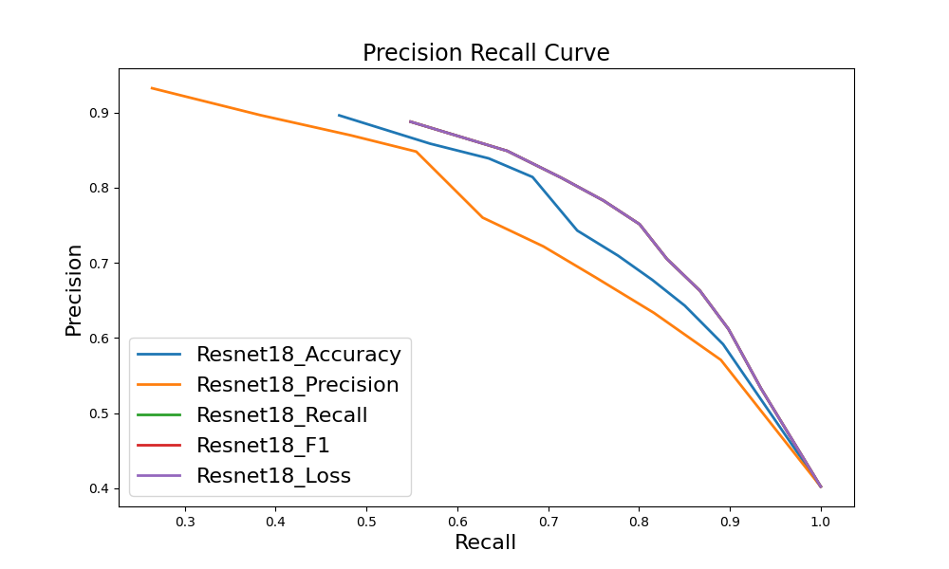

Slide 34
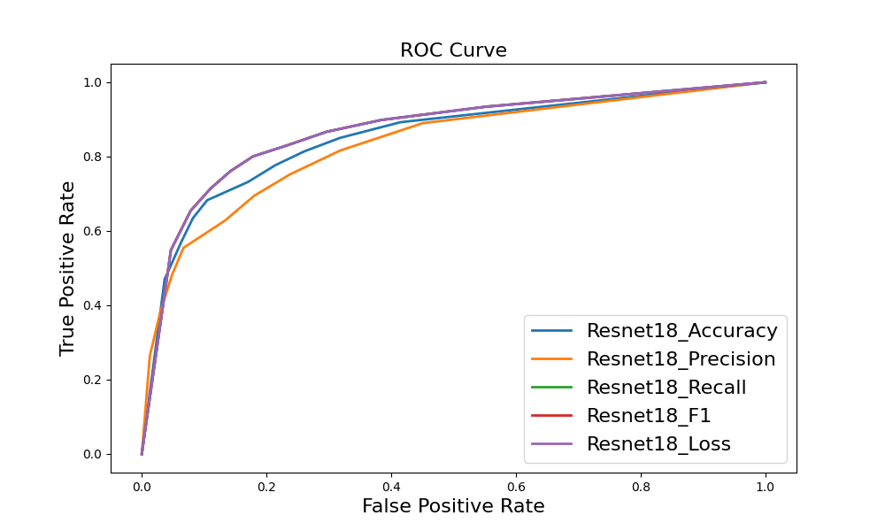

Slide 35
Gap ghmc | Accuracy | precision | recall | specificity | F1 | loss
Resnet18_accuracy | 78.4% | 77.6% | 65.1% | 87.3% | 70.8 | 1.0286
Resnet18_precision | 77.4% | 76.2% | 63.9% | 86.6% | 69.5 | 0.7702
Resnet18_recall | 75.5% | 67% | 77.3% | 74.4% | 71.8 | 0.9117
Resnet18_F1 | 75.4% | 66.4% | 78.8% | 73.1% | 72.1 | 0.9030
Resnet18_loss | 76.7% | 83% | 53.1% | 92.7% | 64.7 | 0.5324

Slide 36
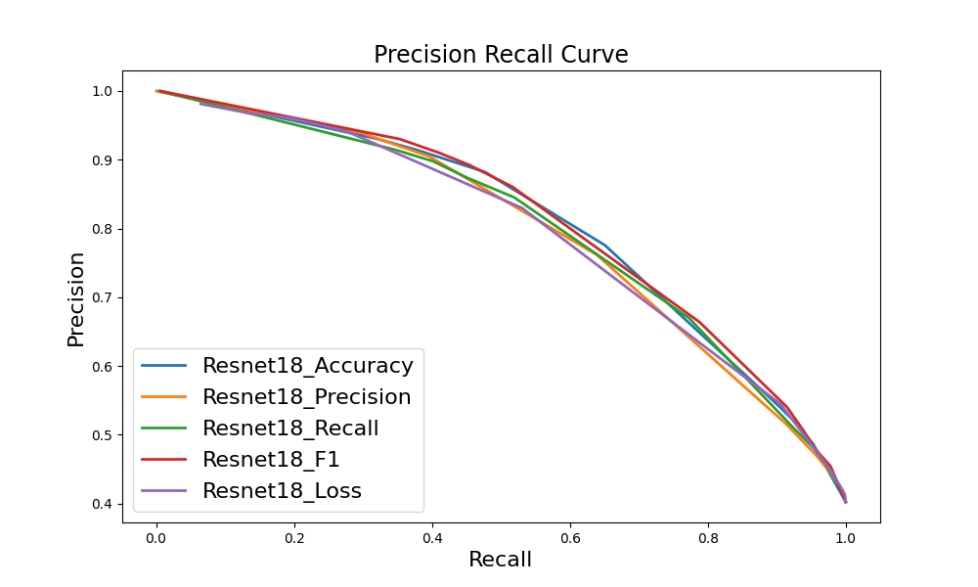

Slide 37
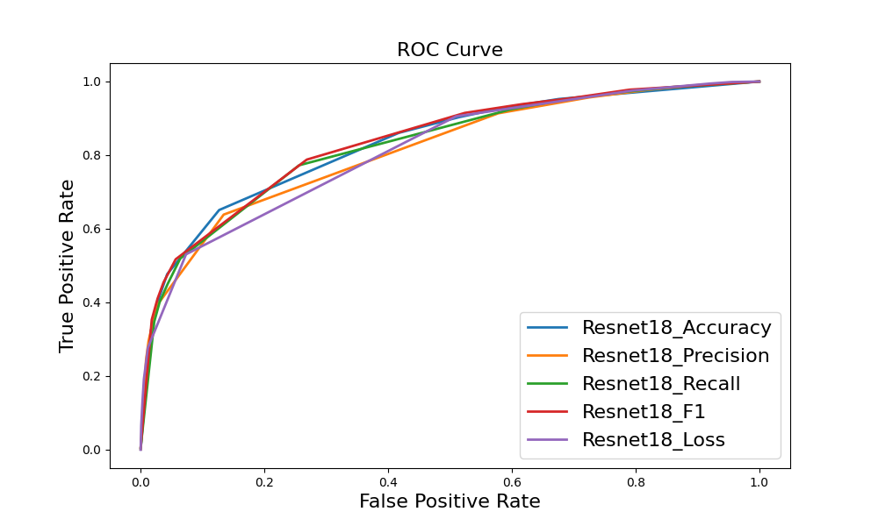

Slide 38
Union Square

Slide 39
Junction | Accuracy | precision | recall | specificity | F1 | loss
Resnet18_accuracy | 85.6% | 83.1% | 68.1% | 93.6% | 74.9 | 0.3546
Resnet18_precision | 85% | 86.9% | 61.7% | 95.7% | 72.2 | 0.3708
Resnet18_recall | 82% | 68.7% | 78.8% | 83.5% | 73.4 | 0.9276
Resnet18_F1 | 85.5% | 83% | 67.9% | 93.6% | 74.7 | 0.3916
Resnet18_loss | 85% | 86.9% | 61.7% | 95.7% | 72.2 | 0.3708

Slide 40
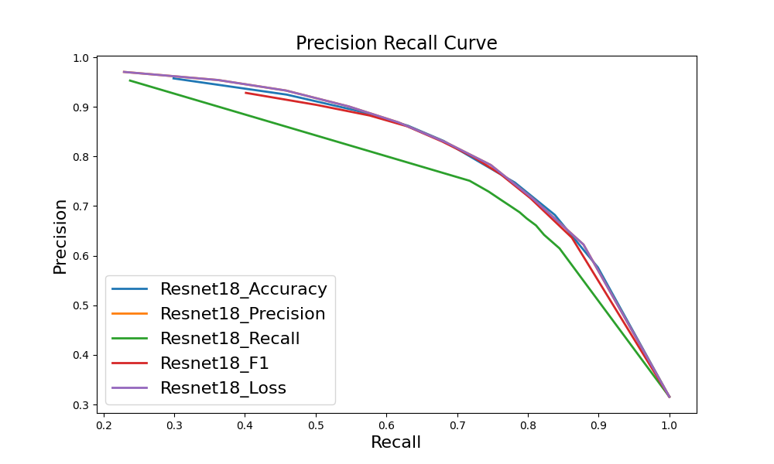

Slide 41
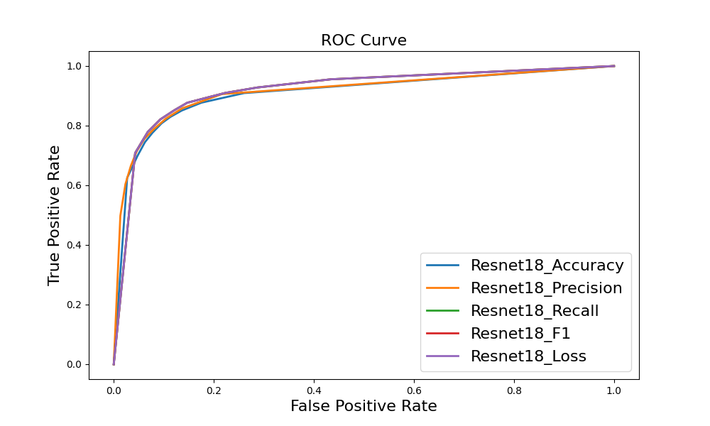

Slide 42
Junction ghmc | Accuracy | precision | recall | specificity | F1 | loss
Resnet18_accuracy | 83.9% | 81.5% | 63.1% | 93.4% | 71.2 | 0.7885
Resnet18_precision | 82.7% | 89.5% | 51.1% | 97.2% | 65 | 0.6606
Resnet18_recall | 79.7% | 63.8% | 82.6% | 78.4% | 72 | 0.5558
Resnet18_F1 | 84% | 75.4% | 72.9% | 89% | 74.2 | 1.3542
Resnet18_loss | 78.4% | 64.2% | 71.1% | 81.7% | 67.5 | 0.5655

Slide 43
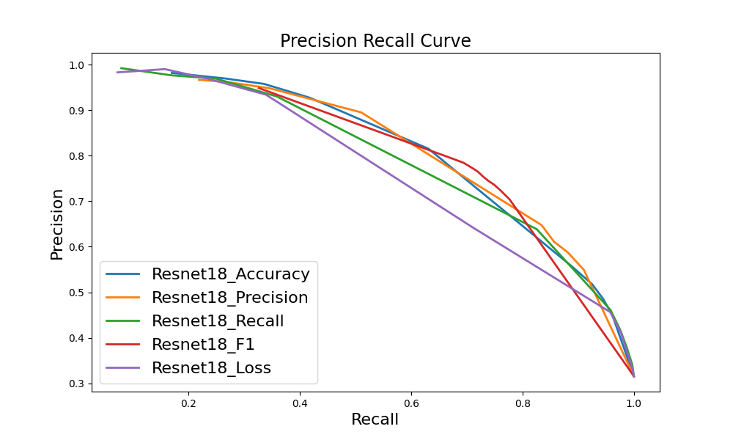

Slide 44
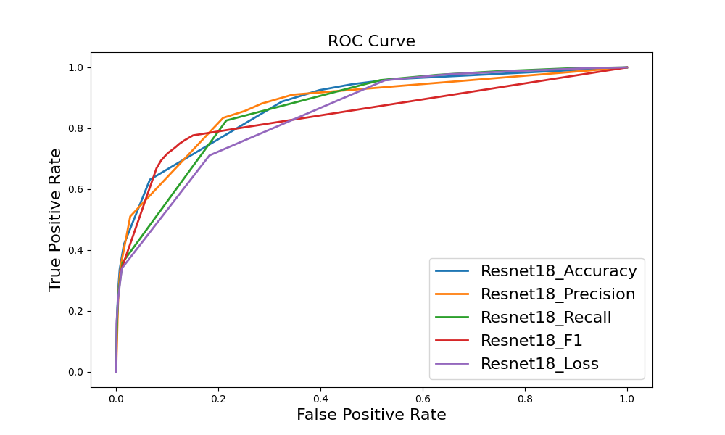

Slide 45
Gap | Accuracy | precision | recall | specificity | F1 | loss
Resnet18_accuracy | 86.3% | 86.4% | 80.8% | 90.4% | 83.5 | 0.3696
Resnet18_precision | 86% | 90.3% | 75.6% | 93.9% | 82.3 | 0.3572
Resnet18_recall | 86.3% | 81.8% | 87.7% | 85.3% | 84.6 | 0.3592
Resnet18_F1 | 86.3% | 81.8% | 87.7% | 85.3% | 84.6 | 0.3592
Resnet18_loss | 86.3% | 81.8% | 87.7% | 85.3% | 84.6 | 0.3592

Slide 46
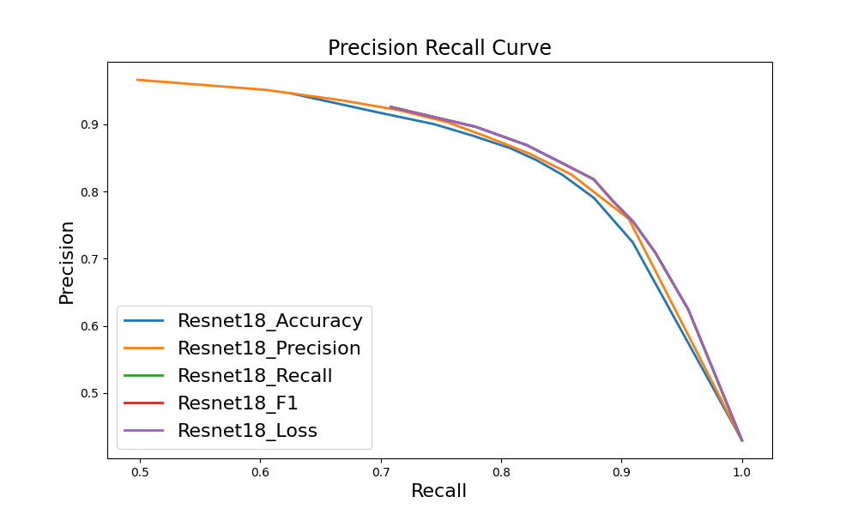

Slide 48
Gap ghmc | Accuracy | precision | recall | specificity | F1 | loss
Resnet18_accuracy | 85.4% | 86.8% | 77.8% | 91.1% | 82.1 | 1.0331
Resnet18_precision | 83.9% | 86.8% | 73.7% | 91.5% | 79.7 | 0.7982
Resnet18_recall | 83.6% | 77.8% | 86.5% | 81.4% | 81.9 | 0.8665
Resnet18_F1 | 82.7% | 76.2% | 86.6% | 79.7% | 81.1 | 0.9013
Resnet18_loss | 80.1% | 85.2% | 65% | 91.5% | 73.7 | 0.6012

Slide 49
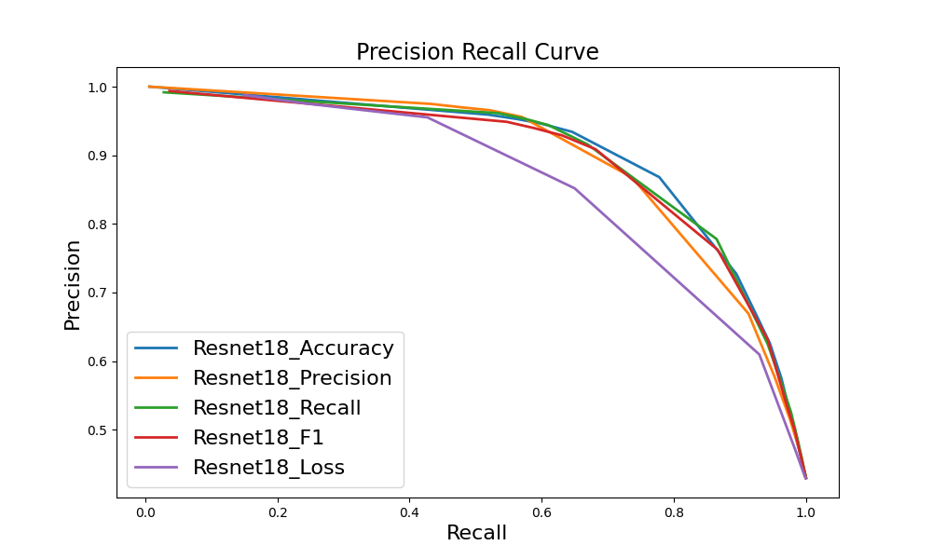

Slide 50
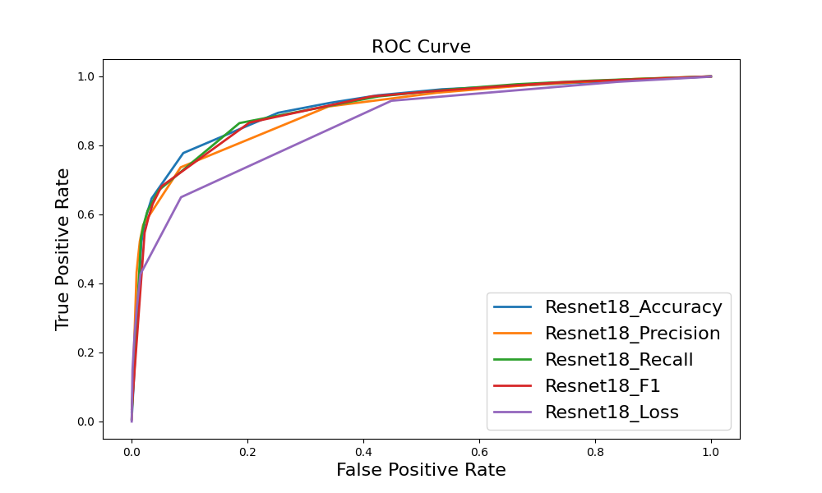

Slide 51
Classification Accuracy for Each Bit

Slide 52
Statistic accuracy for each bit
 |  | Bit 1 | Bit 2 | Bit 3 | Bit 4
Wall Street | Whole area | 71.72% | 81.08% | 71.56% | 81.56%
 | test routes | 75.27% | 83.45% | 76.19% | 85.15%
Union Square | Whole area | 81.5% | 86.58% | 82.52% | 86.08%
 | test routes | 81.39% | 87.55% | 82.28% | 86.61%
Hudson River | Whole area | 78.12% | 84.2% | 78.24% | 84.24%
 | test routes | 79.52% | 84.86% | 80.65% | 85.54%

Slide 53
Statistic accuracy for each category
 |  | junction | Non_junction | gap | Non_gap
Wall Street | Whole area | 65.09% | 76.5% | 80.06% | 82.17%
 | test routes | 72.19% | 77.99% | 85.07% | 83.59%
Union Square | Whole area | 78.83% | 83.47% | 87.69% | 85.31%
 | test routes | 77.12% | 83.88% | 89.11% | 85.57%
Hudson River | Whole area | 75.91% | 79.15% | 80.9% | 85.9%
 | test routes | 79.29% | 80.38% | 83.49% | 86.27%

Slide 54
Bit Flipping v2

Slide 55
Statistic accuracy for each bit
 |  | Bit 1 | Bit 2 | Bit 3 | Bit 4
Wall Street | Whole area | 72.06% | 80.56% | 70.54% | 81.82%
 | test routes | 72.42% | 81.65% | 71.4% | 81.34%
Union Square | Whole area | 81.5% | 86.2% | 82.2% | 86.58%
 | test routes | 80.84% | 86.19% | 82.04% | 86.67%

Slide 56
Statistic accuracy for each category
 |  | junction | Non_junction | gap | Non_gap
Wall Street | Whole area | 71.50% | 71.15% | 81.56% | 80.93%
 | test routes | 72.48% | 71.54% | 81.92% | 81.11%
Union Square | Whole area | 82.45% | 81.58% | 86.92% | 85.99%
 | test routes | 82.3% | 81.06% | 87.08% | 85.94%

Slide 57
Bit Flipping v3

Slide 58
Statistic accuracy for each bit
 |  | Bit 1 | Bit 2 | Bit 3 | Bit 4
Wall Street | Whole area | 71% | 81.64% | 71.68% | 81.46%
 | test routes | 70.32% | 81.81% | 72.96% | 80.75%
Union Square | Whole area | 81.96% | 85.82% | 82.54% | 85.62%
 | test routes | 82.24% | 85.62% | 82.4% | 85.69%

Slide 59
Statistic accuracy for each category
 |  | junction | Non_junction | gap | Non_gap
Wall Street | Whole area | 65.52% | 75.66% | 80.19% | 82.46%
 | test routes | 65.41% | 75.63% | 79.95% | 82.5%
Union Square | Whole area | 80.51% | 83.05% | 87.36% | 84.48%
 | test routes | 81.18% | 82.81% | 87.11% | 84.57%

Slide 60
Localisation Accuracy with different classifiers

Slide 61
Localisation Accuracy With Real Classifier (with Turns)
 | 5 | 10 | 15 | 20 | 25 | 30 | 35 | 40
Wall street | 0.038 | 0.352 | 0.662 | 0.82 | 0.898 | 0.942 | 0.96 | 0.952
v2 | 0.118 | 0.522 | 0.85 | 0.946 | 0.978 | 0.978 | 0.988 | 0.972
v3 | 0.072 | 0.488 | 0.834 | 0.948 | 0.974 | 0.98 | 0.992 | 0.968
Union square | 0.036 | 0.172 | 0.352 | 0.522 | 0.718 | 0.836 | 0.898 | 0.928
v2 | 0.136 | 0.496 | 0.794 | 0.916 | 0.982 | 0.992 | 0.994 | 0.986
v3 | 0.136 | 0.532 | 0.806 | 0.92 | 0.978 | 0.988 | 0.992 | 0.982

Slide 62
Localisation Accuracy With Real Classifier (without Turns)
 | 5 | 10 | 15 | 20 | 25 | 30 | 35 | 40
Wall street | 0.018 | 0.084 | 0.252 | 0.374 | 0.546 | 0.604 | 0.662 | 0.67
v2 | 0.052 | 0.218 | 0.458 | 0.652 | 0.85 | 0.86 | 0.876 | 0.886
v3 | 0.018 | 0.182 | 0.444 | 0.614 | 0.794 | 0.846 | 0.87 | 0.882
Union square | 0.02 | 0.078 | 0.146 | 0.262 | 0.35 | 0.472 | 0.558 | 0.644
v2 | 0.082 | 0.34 | 0.6 | 0.804 | 0.896 | 0.924 | 0.95 | 0.922
v3 | 0.08 | 0.368 | 0.656 | 0.79 | 0.898 | 0.92 | 0.936 | 0.91

Slide 63
BSD Distribution for Different Versions

Slide 64
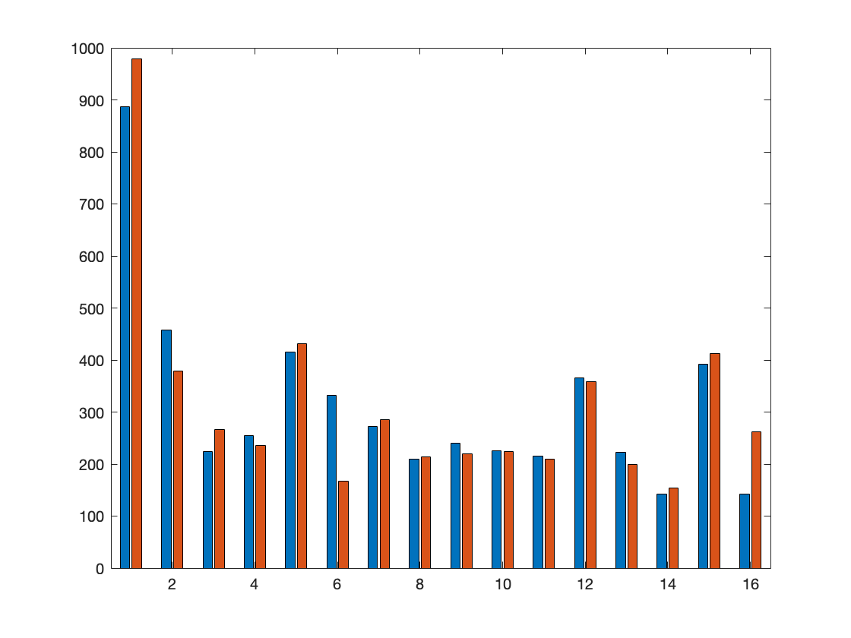
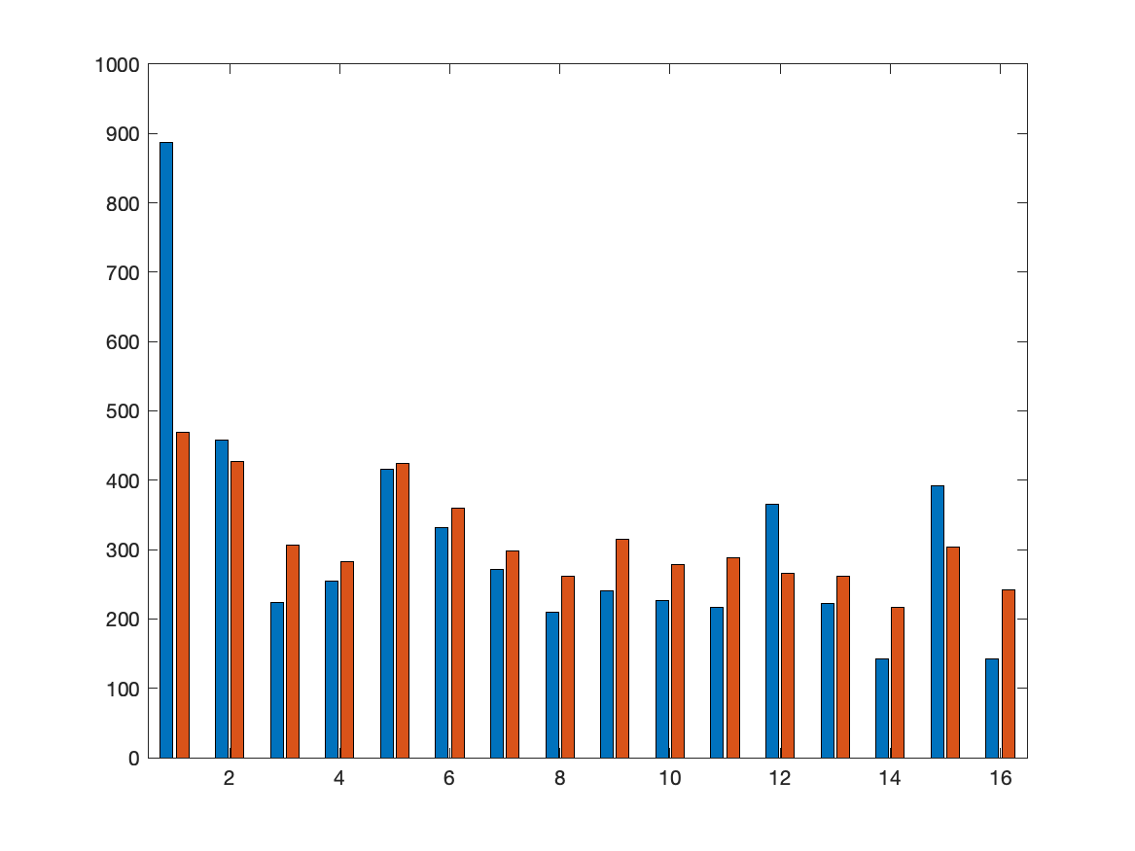
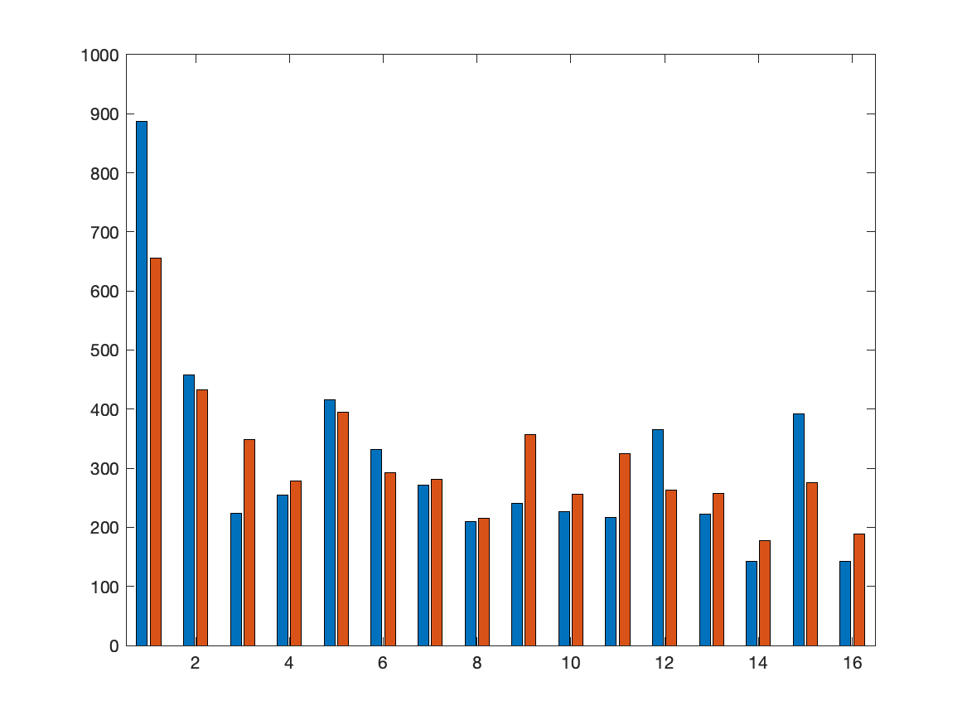
Wall Street
real
v2
v3

Slide 65
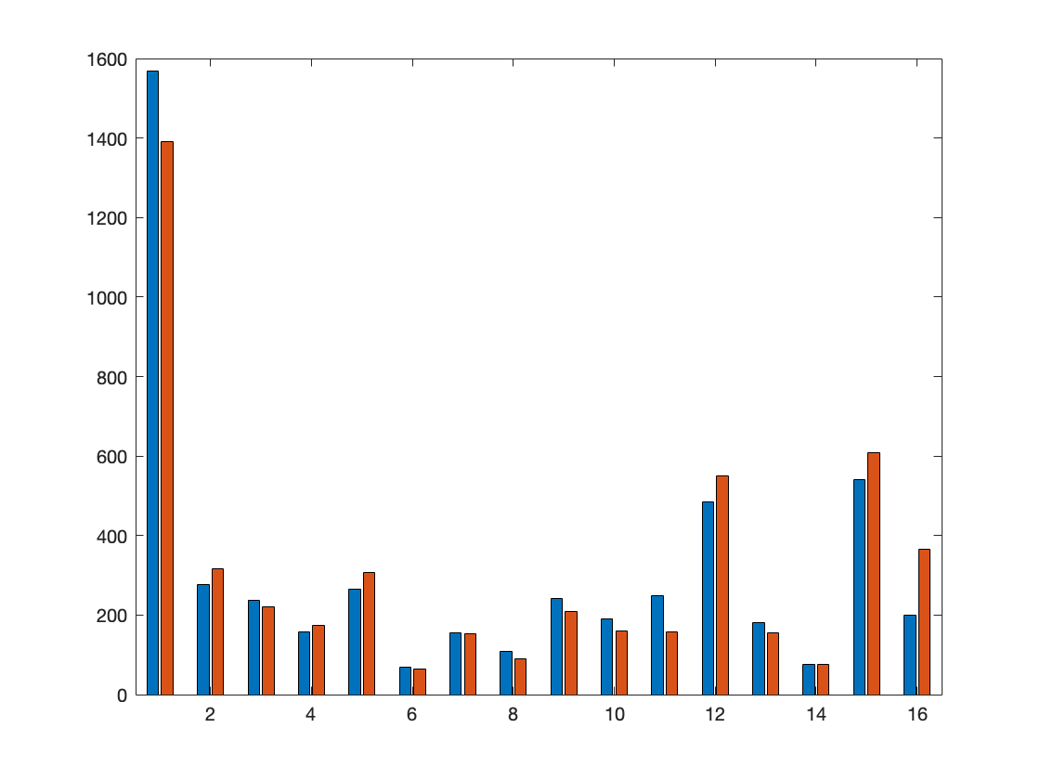
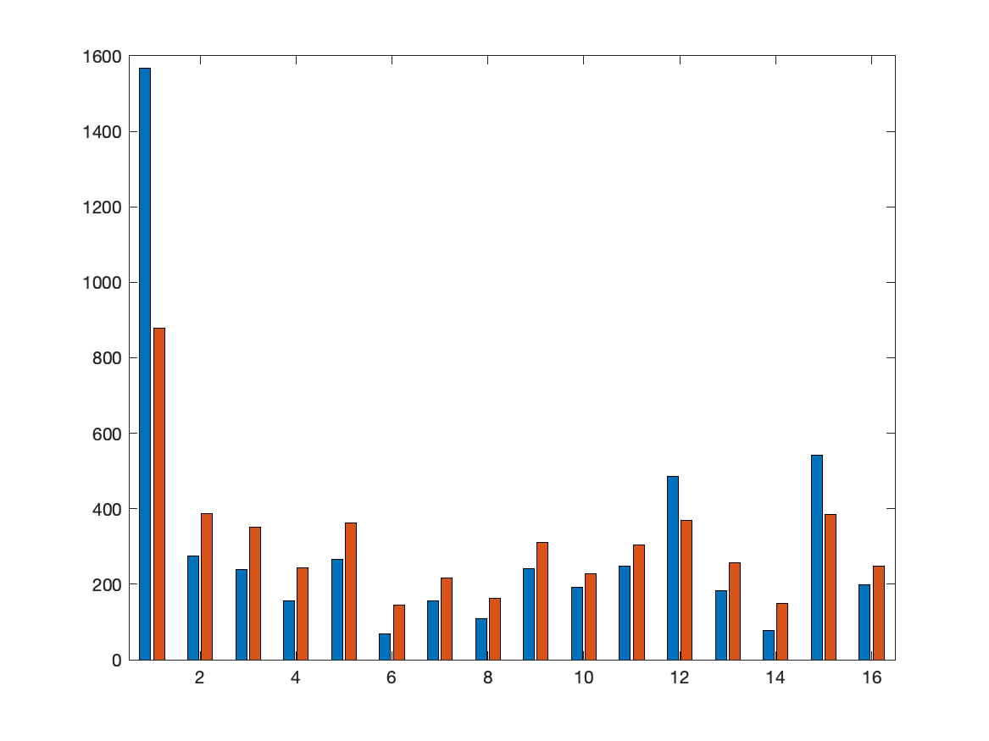

Union Square
real
v2
v3

Slide 66
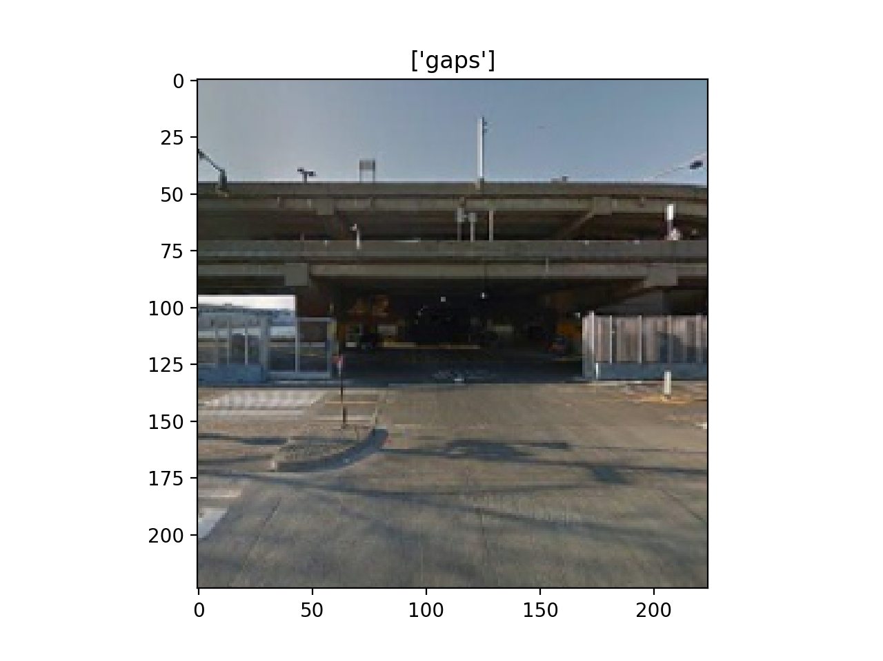
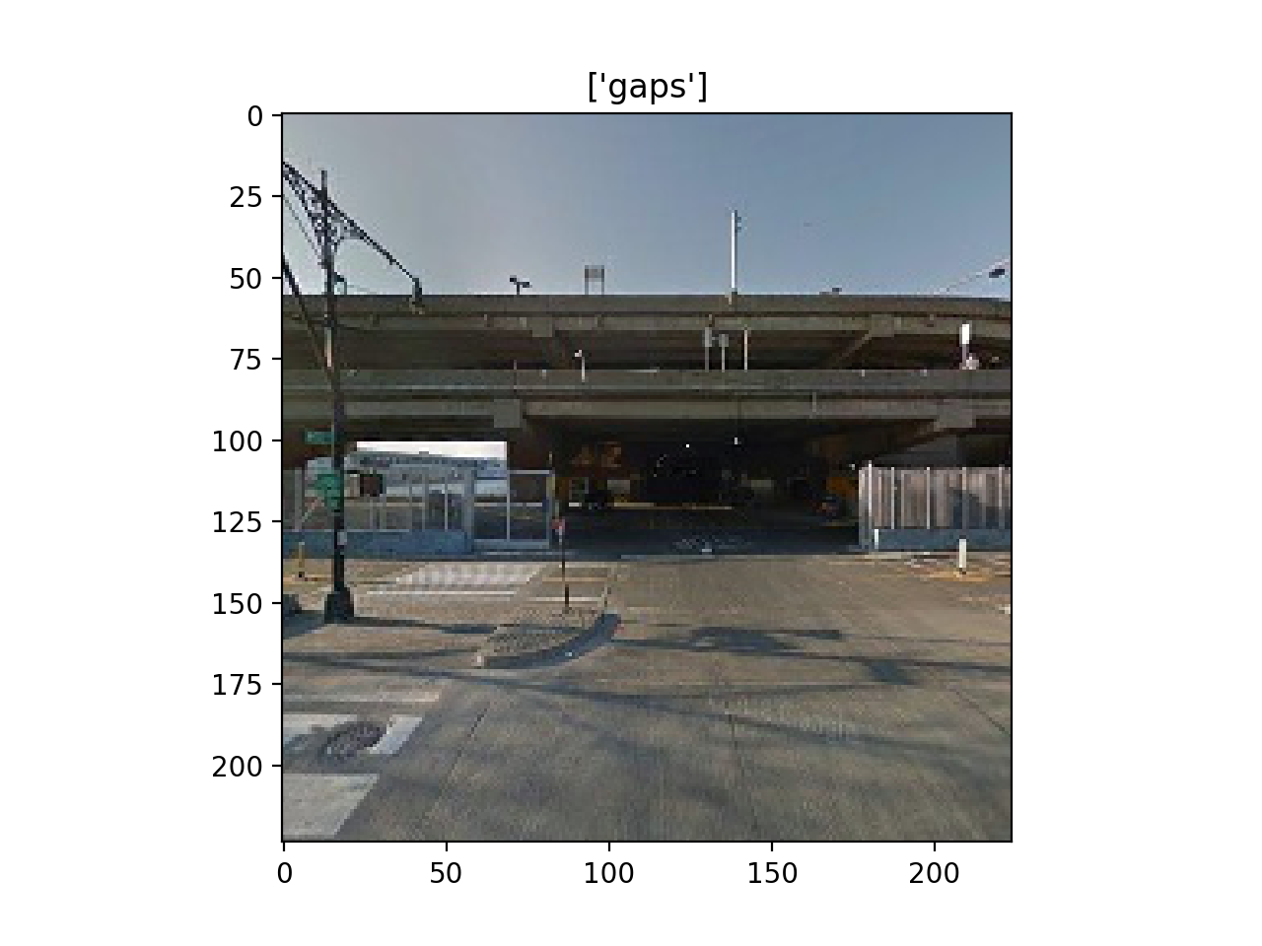
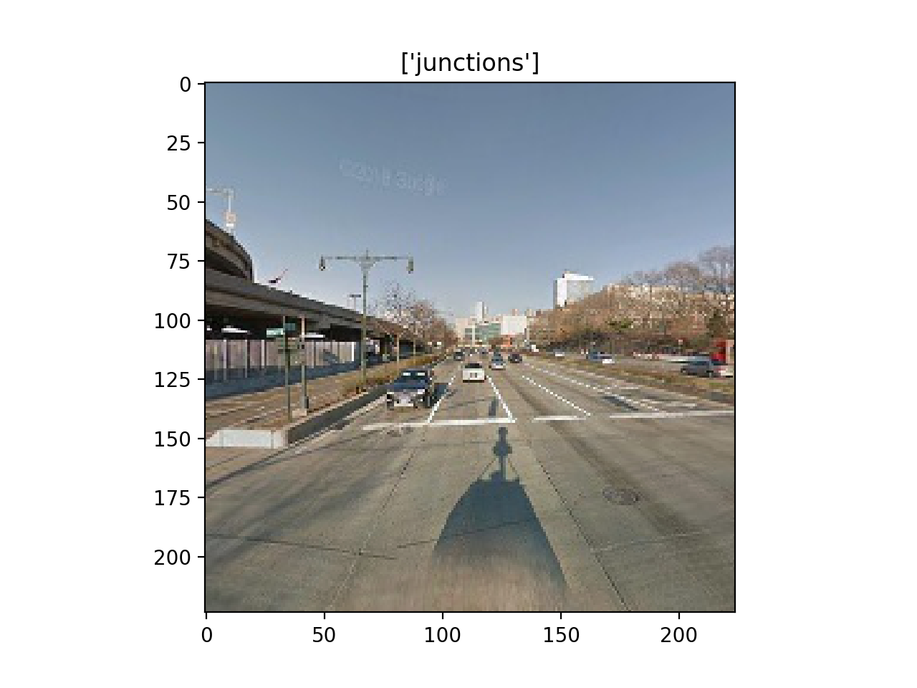
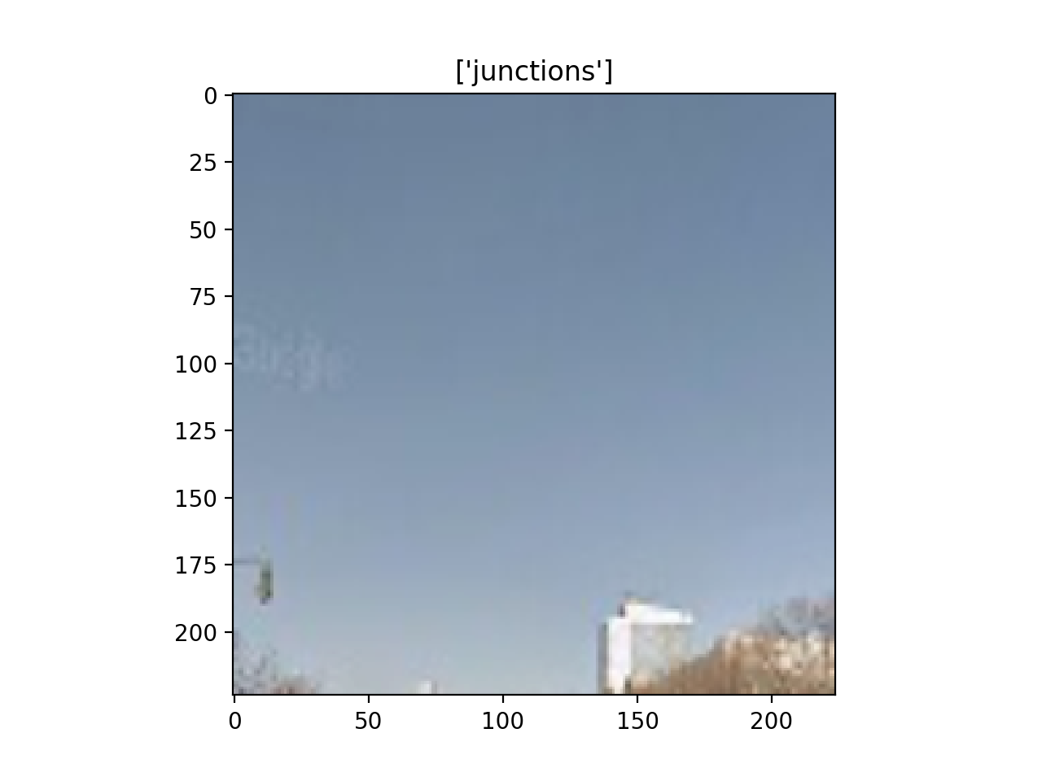
Some Errors

Slide 67
Route Distribution for Different Versions

Slide 68
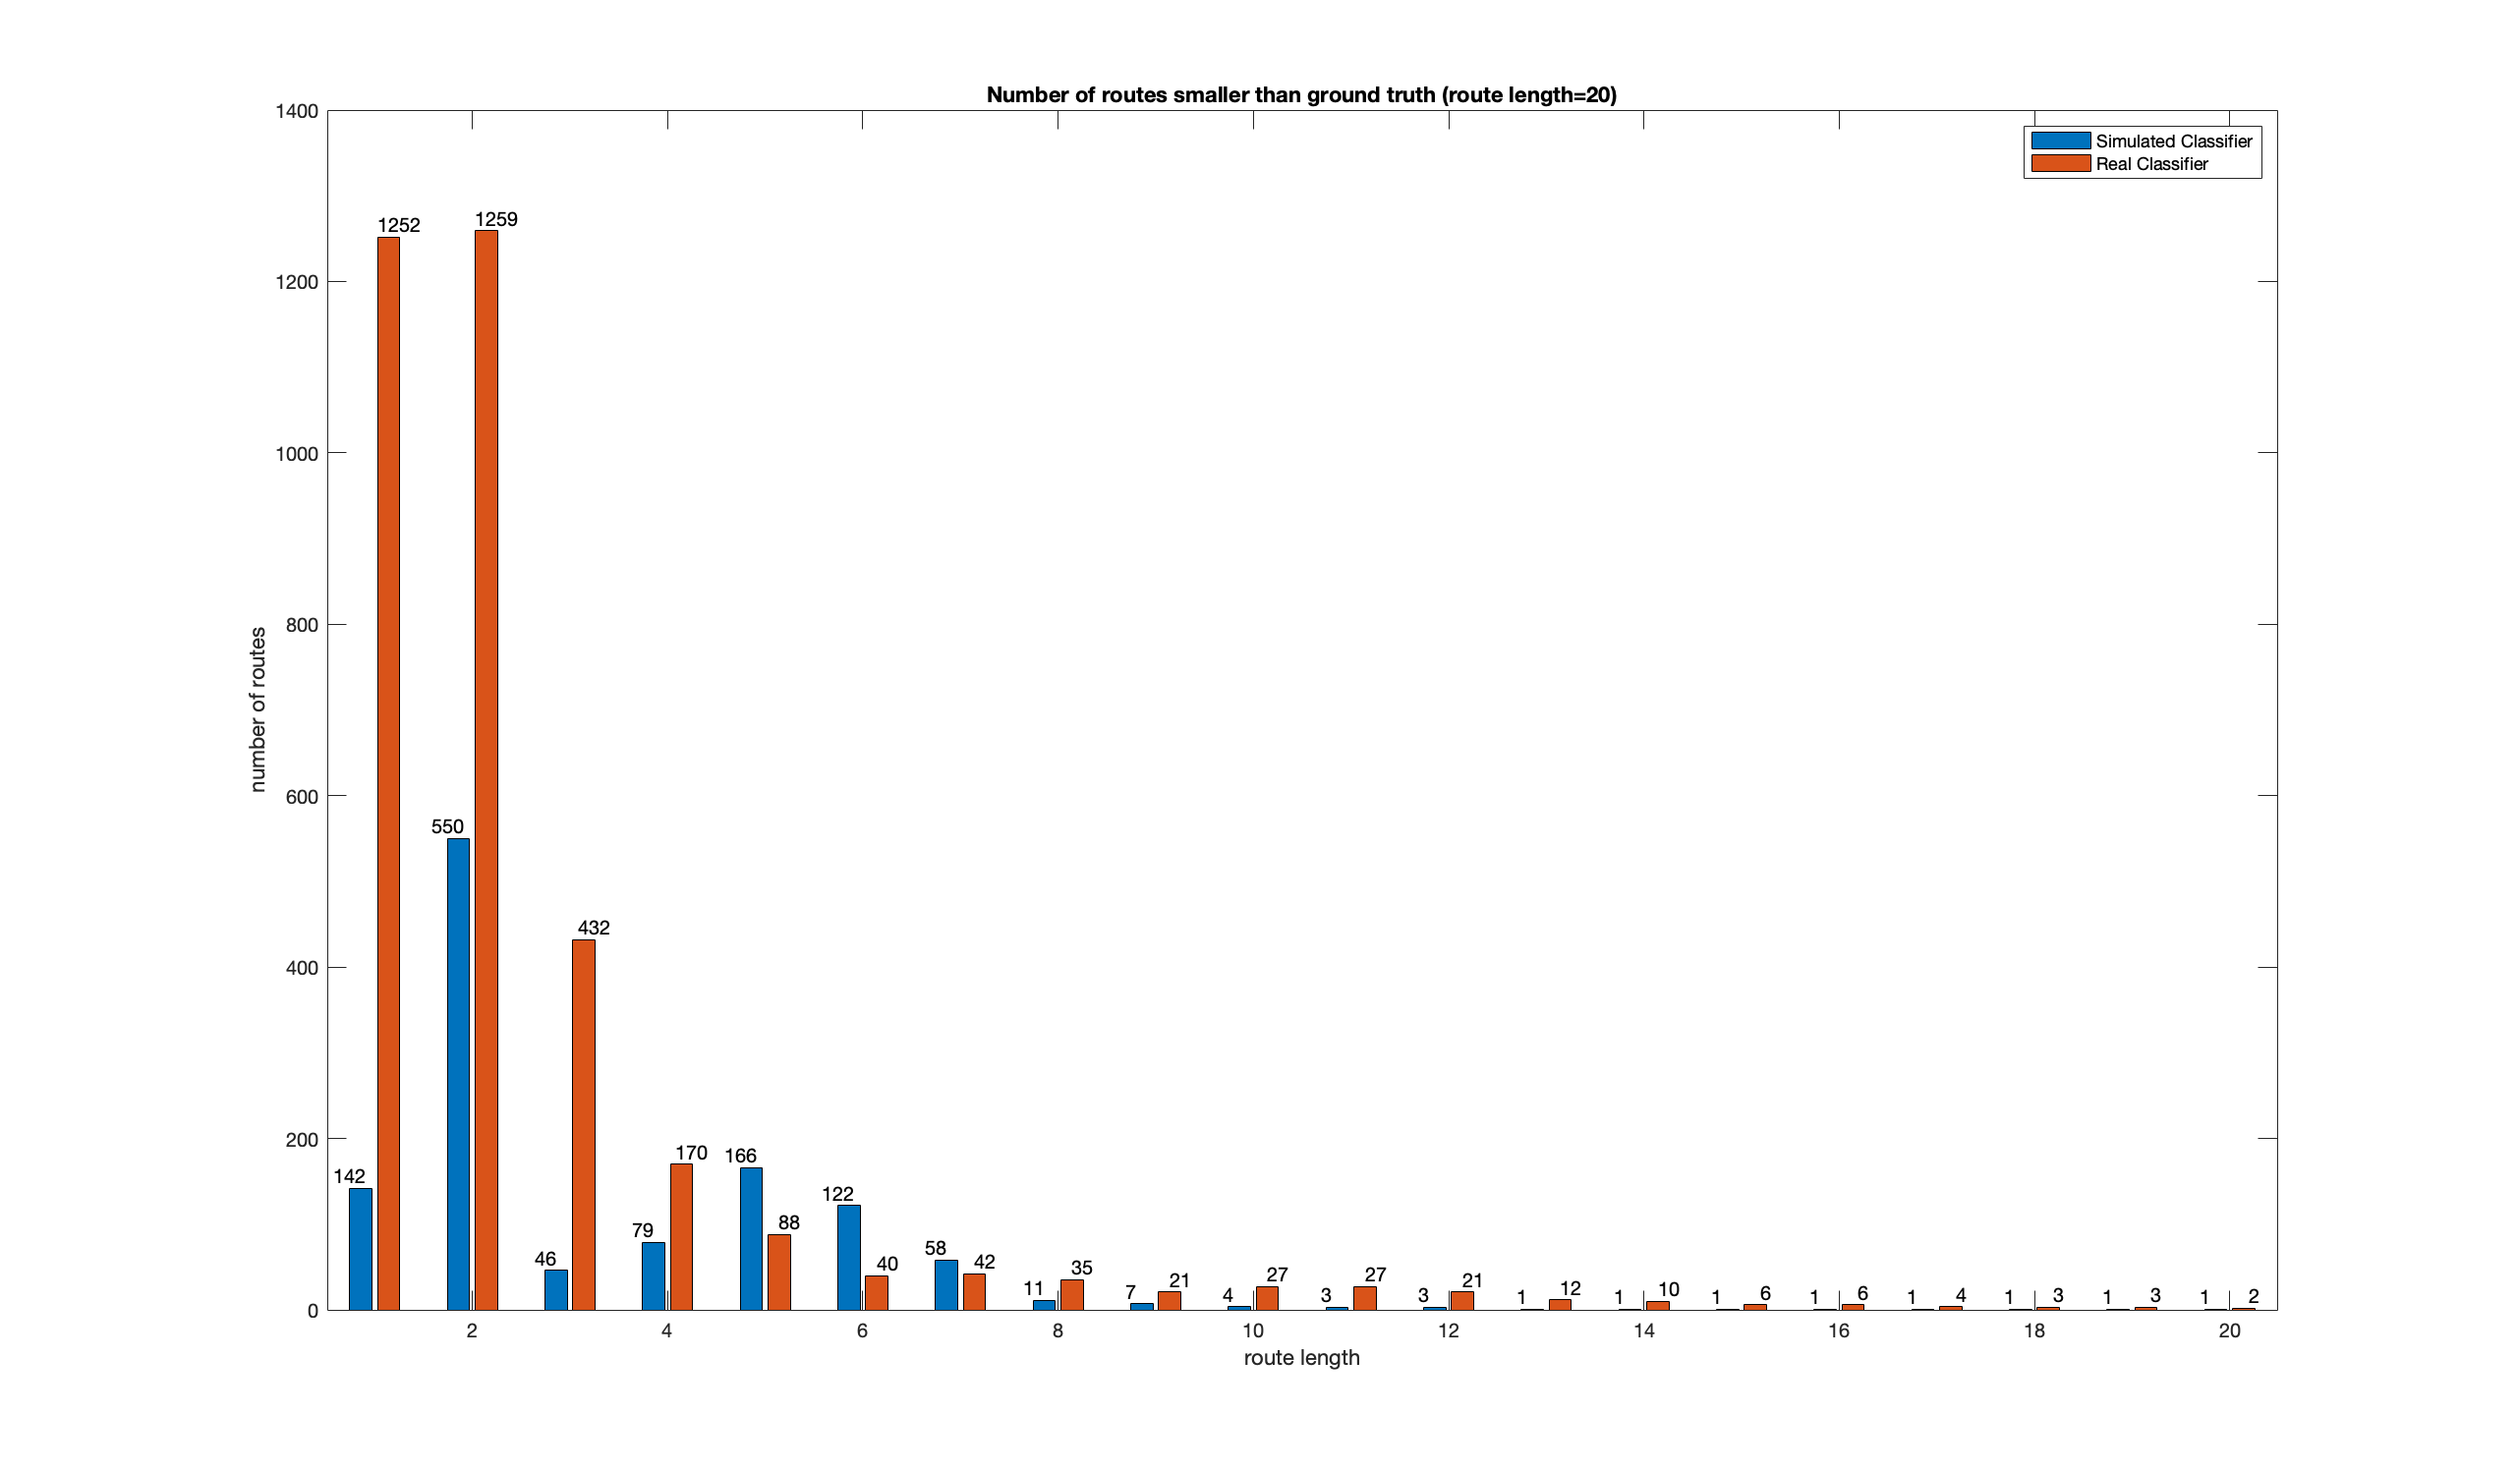
Route 1

Slide 69
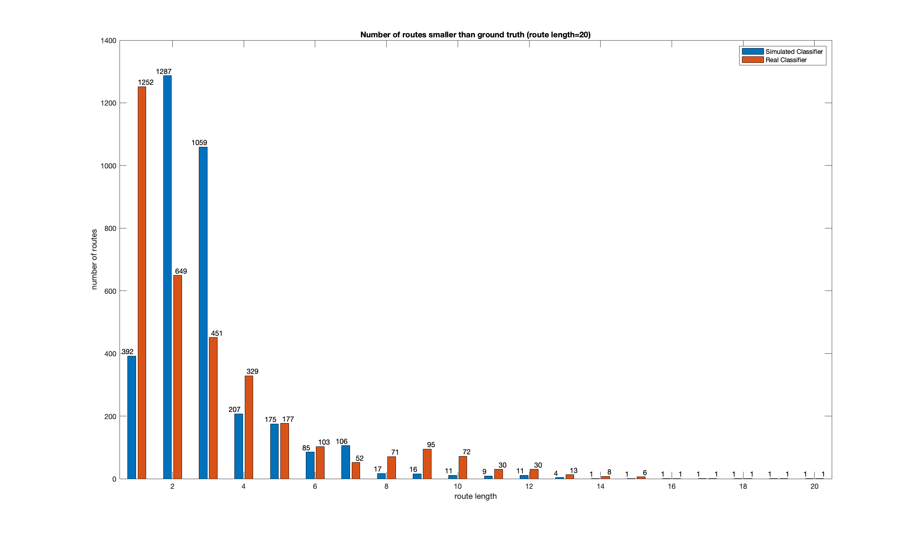
Route 60

Slide 70
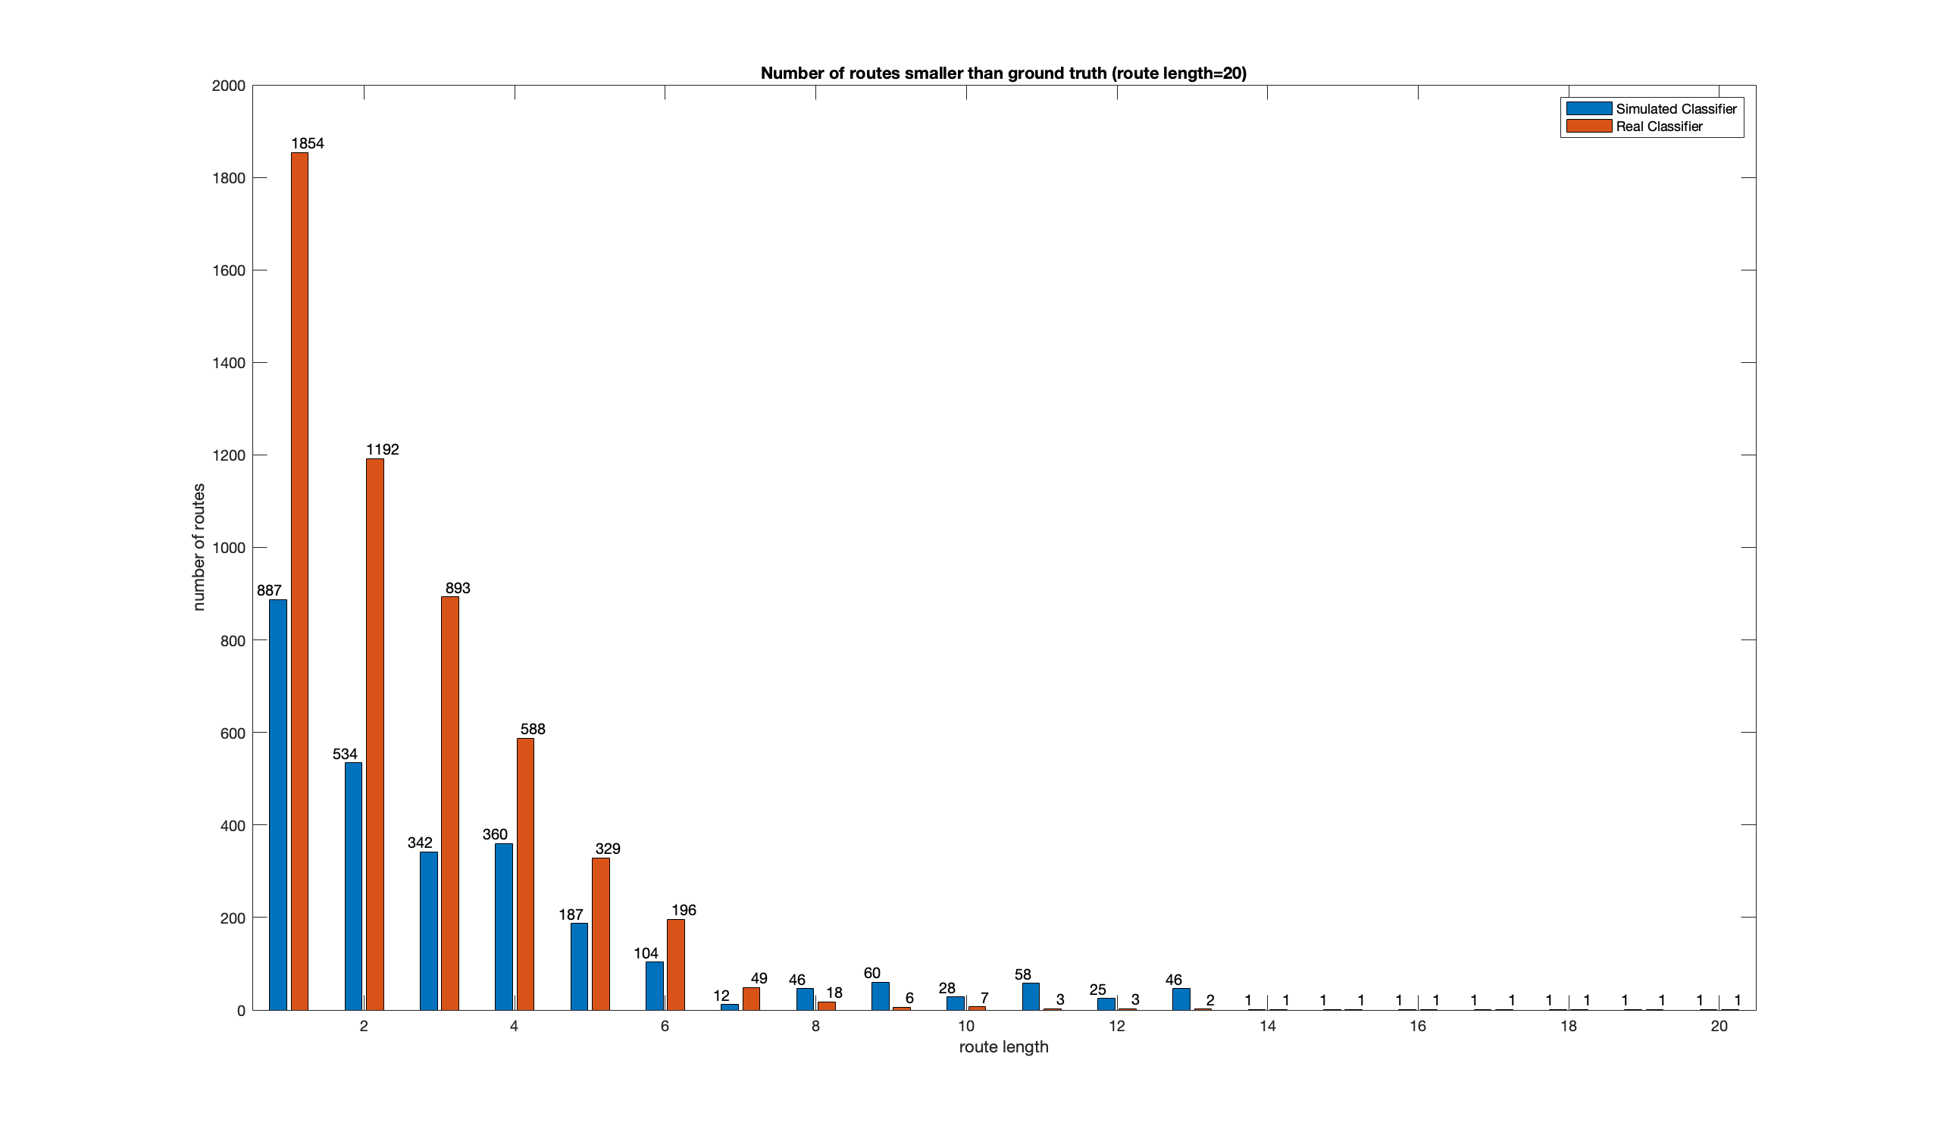
Route 120

Slide 71
Different Models

Slide 72
Hudson River

Slide 73
Junction | Accuracy | precision | recall | specificity | F1 | loss
Alexnet_accuracy | 0.804 | 0.699 | 0.607 | 0.888 | 0.650 | 0.4562
Alexnet_precision | 0.779 | 0.734 | 0.410 | 0.937 | 0.526 | 0.5238
Alexnet_recall | 0.722 | 0.524 | 0.756 | 0.707 | 0.619 | 0.5376
Alexnet_F1 | 0.795 | 0.662 | 0.646 | 0.859 | 0.654 | 0.4848
Alexnet_loss | 0.80 | 0.700 | 0.578 | 0.895 | 0.633 | 0.4555

Slide 74
Gap | Accuracy | precision | recall | specificity | F1 | loss
Alexnet_accuracy | 0.826 | 0.773 | 0.683 | 0.898 | 0.725 | 0.4196
Alexnet_precision | 0.808 | 0.797 | 0.577 | 0.925 | 0.670 | 0.4401
Alexnet_recall | 0.337 | 0.337 | 1.000 | 0.000 | 0.504 | 0.7061
Alexnet_F1 | 0.823 | 0.760 | 0.695 | 0.889 | 0.726 | 0.4435
Alexnet_loss | 0.826 | 0.773 | 0.683 | 0.898 | 0.725 | 0.4196

Slide 75
Gap_v2 | Accuracy | precision | recall | specificity | F1 | loss
Alexnet_accuracy | 0.826 | 0.757 | 0.713 | 0.884 | 0.734 | 0.4193
Alexnet_precision | 0.813 | 0.828 | 0.561 | 0.941 | 0.669 | 0.4338
Alexnet_recall | 0.762 | 0.616 | 0.784 | 0.751 | 0.689 | 0.4985
Alexnet_F1 | 0.826 | 0.757 | 0.713 | 0.884 | 0.734 | 0.4193
Alexnet_loss | 0.824 | 0.800 | 0.636 | 0.919 | 0.709 | 0.4125

Slide 76
Junction | Accuracy | precision | recall | specificity | F1 | loss
resnet50_accuracy | 0.832 | 0.764 | 0.633 | 0.917 | 0.692 | 0.4048
resnet50_precision | 0.826 | 0.808 | 0.548 | 0.944 | 0.653 | 0.4004
resnet50_recall | 0.746 | 0.552 | 0.799 | 0.723 | 0.653 | 1.1484
resnet50_F1 | 0.825 | 0.700 | 0.725 | 0.867 | 0.712 | 0.4099
resnet50_loss | 0.826 | 0.808 | 0.548 | 0.944 | 0.653 | 0.4004

Slide 77
Gap | Accuracy | precision | recall | specificity | F1 | loss
resnet50_accuracy | 0.852 | 0.835 | 0.700 | 0.930 | 0.761 | 0.3591
resnet50_precision | 0.843 | 0.853 | 0.647 | 0.943 | 0.736 | 0.3769
resnet50_recall | 0.819 | 0.697 | 0.822 | 0.818 | 0.754 | 0.5043
resnet50_F1 | 0.848 | 0.781 | 0.765 | 0.891 | 0.773 | 0.3773
resnet50_loss | 0.852 | 0.835 | 0.700 | 0.930 | 0.761 | 0.3591

Slide 78
Junction | Accuracy | precision | recall | specificity | F1 | loss
vgg_accuracy | 0.84 | 0.785 | 0.638 | 0.925 | 0.704 | 0.3840
vgg_precision | 0.833 | 0.817 | 0.567 | 0.946 | 0.670 | 0.3952
vgg_recall | 0.770 | 0.582 | 0.817 | 0.750 | 0.680 | 0.5029
vgg_F1 | 0.831 | 0.712 | 0.729 | 0.874 | 0.720 | 0.4053
vgg_loss | 0.840 | 0.785 | 0.638 | 0.925 | 0.704 | 0.3840

Slide 79
Gap | Accuracy | precision | recall | specificity | F1 | loss
vgg_accuracy | 0.853 | 0.786 | 0.774 | 0.893 | 0.780 | 0.4101
vgg_precision | 0.826 | 0.856 | 0.580 | 0.950 | 0.692 | 0.4142
vgg_recall | 0.833 | 0.724 | 0.815 | 0.842 | 0.766 | 0.4144
vgg_F1 | 0.853 | 0.786 | 0.774 | 0.893 | 0.780 | 0.4101
vgg_loss | 0.843 | 0.776 | 0.751 | 0.890 | 0.763 | 0.3945

Slide 80
Junction | Accuracy | precision | recall | specificity | F1 | loss
googlenet_accuracy | 0.837 | 0.755 | 0.673 | 0.907 | 0.712 | 0.3867
googlenet_precision | 0.837 | 0.755 | 0.673 | 0.907 | 0.712 | 0.3867
googlenet_recall | 0.759 | 0.572 | 0.771 | 0.754 | 0.657 | 1.4077
googlenet_F1 | 0.837 | 0.755 | 0.673 | 0.907 | 0.712 | 0.3867
googlenet_loss | 0.837 | 0.755 | 0.673 | 0.907 | 0.712 | 0.3867

Slide 81
Gap | Accuracy | precision | recall | specificity | F1 | loss
googlenet_accuracy | 0.853 | 0.790 | 0.767 | 0.896 | 0.779 | 0.3744
googlenet_precision | 0.847 | 0.839 | 0.677 | 0.934 | 0.749 | 0.3744
googlenet_recall | 0.819 | 0.697 | 0.816 | 0.820 | 0.752 | 0.9594
googlenet_F1 | 0.853 | 0.790 | 0.767 | 0.896 | 0.779 | 0.3744
googlenet_loss | 0.849 | 0.804 | 0.732 | 0.909 | 0.766 | 0.3541

Slide 82
Junction | Accuracy | precision | recall | specificity | F1 | loss
densenet_accuracy | 0.829 | 0.732 | 0.677 | 0.894 | 0.703 | 0.4071
densenet_precision | 0.825 | 0.772 | 0.587 | 0.926 | 0.667 | 0.4151
densenet_recall | 0.764 | 0.578 | 0.776 | 0.759 | 0.662 | 0.6468
densenet_F1 | 0.829 | 0.724 | 0.692 | 0.888 | 0.708 | 0.4041
densenet_loss | 0.825 | 0.719 | 0.683 | 0.886 | 0.700 | 0.4035

Slide 83
Gap | Accuracy | precision | recall | specificity | F1 | loss
densenet_accuracy | 0.851 | 0.778 | 0.779 | 0.887 | 0.779 | 0.3688
densenet_precision | 0.841 | 0.854 | 0.639 | 0.944 | 0.731 | 0.3771
densenet_recall | 0.822 | 0.707 | 0.804 | 0.831 | 0.753 | 1.3004
densenet_F1 | 0.851 | 0.777 | 0.781 | 0.886 | 0.779 | 0.3806
densenet_loss | 0.851 | 0.778 | 0.779 | 0.887 | 0.779 | 0.3688

Slide 84
Wall Street

Slide 85
Junction | Accuracy | precision | recall | specificity | F1 | loss
Alexnet_accuracy | 0.716 | 0.781 | 0.465 | 0.903 | 0.583 | 0.5634
Alexnet_precision | 0.670 | 0.809 | 0.294 | 0.948 | 0.432 | 0.6087
Alexnet_recall | 0.687 | 0.633 | 0.628 | 0.730 | 0.631 | 0.5961
Alexnet_F1 | 0.710 | 0.759 | 0.469 | 0.890 | 0.580 | 0.5622
Alexnet_loss | 0.698 | 0.779 | 0.405 | 0.915 | 0.533 | 0.5894

Slide 86
Gap | Accuracy | precision | recall | specificity | F1 | loss
Alexnet_accuracy | 0.753 | 0.729 | 0.617 | 0.845 | 0.668 | 0.5339
Alexnet_precision | 0.742 | 0.779 | 0.502 | 0.904 | 0.610 | 0.5527
Alexnet_recall | 0.402 | 0.402 | 1.000 | 0.000 | 0.574 | 0.7015
Alexnet_F1 | 0.755 | 0.5633 | 0.720 | 0.642 | 0.679 | 0.832
Alexnet_loss | 0.753 | 0.5339 | 0.729 | 0.617 | 0.668 | 0.845

Slide 87
Gap_v2 | Accuracy | precision | recall | specificity | F1 | loss
Alexnet_accuracy | 0.762 | 0.721 | 0.668 | 0.826 | 0.693 | 0.5104
Alexnet_precision | 0.748 | 0.793 | 0.507 | 0.911 | 0.618 | 0.5331
Alexnet_recall | 0.718 | 0.633 | 0.711 | 0.723 | 0.670 | 0.5514
Alexnet_F1 | 0.762 | 0.721 | 0.668 | 0.826 | 0.693 | 0.5104
Alexnet_loss | 0.770 | 0.788 | 0.586 | 0.894 | 0.672 | 0.5140

Slide 88
Junction | Accuracy | precision | recall | specificity | F1 | loss
resnet50_accuracy | 0.738 | 0.826 | 0.487 | 0.924 | 0.613 | 0.5908
resnet50_precision | 0.717 | 0.873 | 0.392 | 0.958 | 0.541 | 0.5967
resnet50_recall | 0.694 | 0.621 | 0.721 | 0.673 | 0.667 | 1.2624
resnet50_F1 | 0.741 | 0.773 | 0.554 | 0.879 | 0.646 | 0.5312
resnet50_loss | 0.717 | 0.873 | 0.392 | 0.958 | 0.541 | 0.5967

Slide 89
Gap | Accuracy | precision | recall | specificity | F1 | loss
resnet50_accuracy | 0.814 | 0.843 | 0.661 | 0.917 | 0.741 | 0.4384
resnet50_precision | 0.793 | 0.828 | 0.612 | 0.914 | 0.704 | 0.4541
resnet50_recall | 0.778 | 0.697 | 0.795 | 0.767 | 0.743 | 0.5829
resnet50_F1 | 0.798 | 0.748 | 0.752 | 0.829 | 0.750 | 0.4616
resnet50_loss | 0.814 | 0.843 | 0.661 | 0.917 | 0.741 | 0.4384

Slide 90
Junction | Accuracy | precision | recall | specificity | F1 | loss
googlenet_accuracy | 0.745 | 0.805 | 0.528 | 0.905 | 0.638 | 0.5208
googlenet_precision | 0.745 | 0.805 | 0.528 | 0.905 | 0.638 | 0.5208
googlenet_recall | 0.703 | 0.636 | 0.709 | 0.699 | 0.670 | 1.6266
googlenet_F1 | 0.745 | 0.805 | 0.528 | 0.905 | 0.638 | 0.5208
googlenet_loss | 0.745 | 0.805 | 0.528 | 0.905 | 0.638 | 0.5208

Slide 91
Gap | Accuracy | precision | recall | specificity | F1 | loss
googlenet_accuracy | 0.804 | 0.759 | 0.754 | 0.839 | 0.756 | 0.4504
googlenet_precision | 0.799 | 0.808 | 0.656 | 0.895 | 0.724 | 0.4493
googlenet_recall | 0.777 | 0.701 | 0.777 | 0.777 | 0.737 | 1.0550
googlenet_F1 | 0.804 | 0.759 | 0.754 | 0.839 | 0.756 | 0.4504
googlenet_loss | 0.803 | 0.785 | 0.702 | 0.871 | 0.741 | 0.4566

Slide 92
Junction | Accuracy | precision | recall | specificity | F1 | loss
vgg_accuracy | 0.746 | 0.833 | 0.504 | 0.925 | 0.628 | 0.5254
vgg_precision | 0.728 | 0.868 | 0.427 | 0.952 | 0.572 | 0.5608
vgg_recall | 0.731 | 0.681 | 0.693 | 0.759 | 0.687 | 0.5395
vgg_F1 | 0.748 | 0.767 | 0.586 | 0.868 | 0.664 | 0.5223
vgg_loss | 0.746 | 0.833 | 0.504 | 0.925 | 0.628 | 0.5254

Slide 93
Gap | Accuracy | precision | recall | specificity | F1 | loss
vgg_accuracy | 0.806 | 0.760 | 0.758 | 0.839 | 0.759 | 0.4755
vgg_precision | 0.768 | 0.820 | 0.543 | 0.920 | 0.654 | 0.5010
vgg_recall | 0.782 | 0.706 | 0.785 | 0.780 | 0.743 | 0.4916
vgg_F1 | 0.806 | 0.760 | 0.758 | 0.839 | 0.759 | 0.4755
vgg_loss | 0.788 | 0.753 | 0.705 | 0.844 | 0.729 | 0.4869

Slide 94
Junction | Accuracy | precision | recall | specificity | F1 | loss
densenet_accuracy | 0.740 | 0.783 | 0.541 | 0.889 | 0.640 | 0.5581
densenet_precision | 0.712 | 0.814 | 0.418 | 0.929 | 0.553 | 0.5953
densenet_recall | 0.712 | 0.663 | 0.658 | 0.752 | 0.661 | 0.7742
densenet_F1 | 0.736 | 0.778 | 0.532 | 0.887 | 0.632 | 0.5684
densenet_loss | 0.740 | 0.786 | 0.536 | 0.892 | 0.637 | 0.5416

Slide 95
Gap | Accuracy | precision | recall | specificity | F1 | loss
densenet_accuracy | 0.805 | 0.771 | 0.734 | 0.854 | 0.752 | 0.4544
densenet_precision | 0.796 | 0.849 | 0.598 | 0.929 | 0.702 | 0.4689
densenet_recall | 0.771 | 0.695 | 0.765 | 0.775 | 0.728 | 1.5267
densenet_F1 | 0.800 | 0.763 | 0.730 | 0.848 | 0.746 | 0.4674
densenet_loss | 0.805 | 0.771 | 0.734 | 0.854 | 0.752 | 0.4544

Slide 96
Union Square

Slide 97
Junction | Accuracy | precision | recall | specificity | F1 | loss
Alexnet_accuracy | 0.836 | 0.800 | 0.642 | 0.926 | 0.712 | 0.3978
Alexnet_precision | 0.786 | 0.795 | 0.433 | 0.949 | 0.561 | 0.5008
Alexnet_recall | 0.795 | 0.655 | 0.743 | 0.819 | 0.696 | 0.4601
Alexnet_F1 | 0.830 | 0.770 | 0.658 | 0.909 | 0.710 | 0.4212
Alexnet_loss | 0.824 | 0.802 | 0.588 | 0.933 | 0.679 | 0.4071

Slide 98
Gap | Accuracy | precision | recall | specificity | F1 | loss
Alexnet_accuracy | 0.842 | 0.870 | 0.744 | 0.916 | 0.802 | 0.3901
Alexnet_precision | 0.825 | 0.891 | 0.674 | 0.938 | 0.768 | 0.4023
Alexnet_recall | 0.430 | 0.430 | 1.000 | 0.000 | 0.601 | 0.6991
Alexnet_F1 | 0.842 | 0.848 | 0.771 | 0.896 | 0.808 | 0.3852
Alexnet_loss | 0.842 | 0.870 | 0.744 | 0.916 | 0.802 | 0.3901

Slide 99
Gap_v2 | Accuracy | precision | recall | specificity | F1 | loss
Alexnet_accuracy | 0.842 | 0.838 | 0.785 | 0.885 | 0.811 | 0.3823
Alexnet_precision | 0.831 | 0.906 | 0.676 | 0.947 | 0.774 | 0.3980
Alexnet_recall | 0.817 | 0.760 | 0.837 | 0.801 | 0.797 | 0.4195
Alexnet_F1 | 0.842 | 0.838 | 0.785 | 0.885 | 0.811 | 0.3823
Alexnet_loss | 0.829 | 0.864 | 0.716 | 0.915 | 0.783 | 0.4004

Slide 100
Junction | Accuracy | precision | recall | specificity | F1 | loss
resnet50_accuracy | 0.854 | 0.811 | 0.699 | 0.925 | 0.751 | 0.3687
resnet50_precision | 0.848 | 0.871 | 0.607 | 0.959 | 0.716 | 0.3666
resnet50_recall | 0.806 | 0.655 | 0.814 | 0.802 | 0.726 | 0.9444
resnet50_F1 | 0.852 | 0.791 | 0.723 | 0.912 | 0.756 | 0.3535
resnet50_loss | 0.848 | 0.871 | 0.607 | 0.959 | 0.716 | 0.3666

Slide 101
Gap | Accuracy | precision | recall | specificity | F1 | loss
resnet50_accuracy | 0.860 | 0.863 | 0.801 | 0.905 | 0.831 | 0.3473
resnet50_precision | 0.857 | 0.878 | 0.774 | 0.919 | 0.823 | 0.3545
resnet50_recall | 0.851 | 0.799 | 0.872 | 0.835 | 0.834 | 0.4189
resnet50_F1 | 0.866 | 0.846 | 0.840 | 0.885 | 0.843 | 0.3408
resnet50_loss | 0.860 | 0.863 | 0.801 | 0.831 | 0.905 | 0.3473

Slide 102
Junction | Accuracy | precision | recall | specificity | F1 | loss
googlenet_accuracy | 0.859 | 0.817 | 0.713 | 0.926 | 0.762 | 0.3374
googlenet_precision | 0.859 | 0.817 | 0.713 | 0.926 | 0.762 | 0.3374
googlenet_recall | 0.809 | 0.663 | 0.803 | 0.812 | 0.726 | 1.1526
googlenet_F1 | 0.859 | 0.817 | 0.713 | 0.926 | 0.762 | 0.3374
googlenet_loss | 0.859 | 0.817 | 0.713 | 0.926 | 0.762 | 0.3374

Slide 103
Gap | Accuracy | precision | recall | specificity | F1 | loss
googlenet_accuracy | 0.869 | 0.858 | 0.834 | 0.896 | 0.846 | 0.3363
googlenet_precision | 0.868 | 0.901 | 0.779 | 0.935 | 0.835 | 0.3289
googlenet_recall | 0.838 | 0.780 | 0.866 | 0.816 | 0.821 | 0.8072
googlenet_F1 | 0.869 | 0.858 | 0.834 | 0.896 | 0.846 | 0.3363
googlenet_loss | 0.867 | 0.875 | 0.806 | 0.913 | 0.839 | 0.3305

Slide 104
Junction | Accuracy | precision | recall | specificity | F1 | loss
vgg_accuracy | 0.856 | 0.825 | 0.689 | 0.932 | 0.751 | 0.3391
vgg_precision | 0.852 | 0.854 | 0.639 | 0.950 | 0.731 | 0.3583
vgg_recall | 0.806 | 0.645 | 0.859 | 0.782 | 0.737 | 0.4399
vgg_F1 | 0.860 | 0.794 | 0.753 | 0.910 | 0.772 | 0.3415
vgg_loss | 0.856 | 0.825 | 0.689 | 0.932 | 0.751 | 0.3391

Slide 105
Gap | Accuracy | precision | recall | specificity | F1 | loss
vgg_accuracy | 0.860 | 0.827 | 0.854 | 0.865 | 0.840 | 0.3755
vgg_precision | 0.840 | 0.916 | 0.690 | 0.953 | 0.787 | 0.3845
vgg_recall | 0.857 | 0.814 | 0.863 | 0.852 | 0.838 | 0.3560
vgg_F1 | 0.860 | 0.827 | 0.854 | 0.865 | 0.840 | 0.3755
vgg_loss | 0.867 | 0.866 | 0.817 | 0.905 | 0.840 | 0.3456

Slide 106
Junction | Accuracy | precision | recall | specificity | F1 | loss
densenet_accuracy | 0.857 | 0.795 | 0.736 | 0.913 | 0.765 | 0.3604
densenet_precision | 0.839 | 0.849 | 0.597 | 0.951 | 0.701 | 0.3848
densenet_recall | 0.820 | 0.682 | 0.804 | 0.827 | 0.738 | 0.5311
densenet_F1 | 0.856 | 0.814 | 0.706 | 0.925 | 0.756 | 0.3560
densenet_loss | 0.857 | 0.795 | 0.736 | 0.912 | 0.764 | 0.3431

Slide 107
Gap | Accuracy | precision | recall | specificity | F1 | loss
densenet_accuracy | 0.863 | 0.839 | 0.841 | 0.879 | 0.840 | 0.3399
densenet_precision | 0.851 | 0.887 | 0.749 | 0.928 | 0.812 | 0.3650
densenet_recall | 0.843 | 0.794 | 0.857 | 0.833 | 0.824 | 1.1142
densenet_F1 | 0.866 | 0.848 | 0.840 | 0.886 | 0.844 | 0.3387
densenet_loss | 0.863 | 0.839 | 0.841 | 0.879 | 0.840 | 0.3399

Slide 108
Visualization

Slide 109
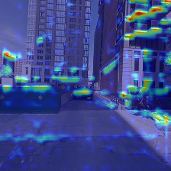
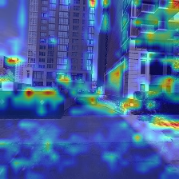
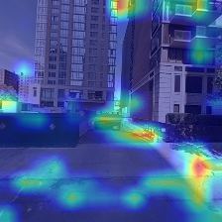
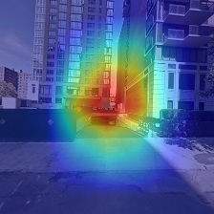
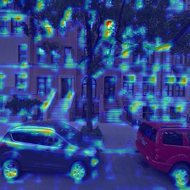
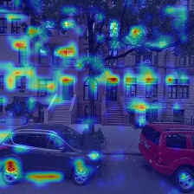
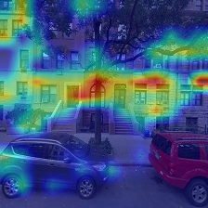
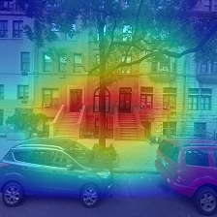
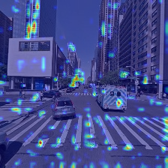







Layer 1
Layer 2
Layer 3
Layer 4
Building Gap
No Building Gap
Junction
No Junction

Slide 110
















Image 1
Image 2
Image 3
Image 4
Image 5
Building Gap
No Building Gap
Junction
No Junction

Slide 111
Resnet 18
 | Image 1 | Image 2 | Image 3 | Image 4 | Image 5
Building Gap | 0.99453 | 0.27181 | 0.99295 | 0.92428 | 0.94444
No Building Gap | 0.98170 | 0.99054 | 0.98009 | 0.98002 | 0.97606
Junction | 0.00090 | 0.99998 | 0.00044 | 0.99998 | 0.00296
No Junction | 0.99826 | 0.99519 | 1.00000 | 0.99946 | 0.91186

Slide 112
Vgg
 | Image 1 | Image 2 | Image 3 | Image 4 | Image 5
Building Gap | 0.80734 | 0.30326 | 0.98268 | 0.85101 | 0.96428
No Building Gap | 0.96848 | 0.97697 | 0.94701 | 0.92968 | 0.81141
Junction | 0.73604 | 0.97133 | 0.26553 | 0.94383 | 0.40466
No Junction | 0.76206 | 0.80352 | 0.95117 | 0.83735 | 0.30593

Slide 113
Resnet50
 | Image 1 | Image 2 | Image 3 | Image 4 | Image 5
Building Gap | 0.99843 | 0.45137 | 0.99659 | 0.89602 | 0.98828
No Building Gap | 0.99058 | 0.99900 | 0.95791 | 0.98979 | 0.98890
Junction | 0.24628 | 1.00000 | 0.26244 | 0.99709 | 0.00004
No Junction | 0.75196 | 0.99454 | 1.00000 | 0.99037 | 0.99999

Slide 114
Densenet161
 | Image 1 | Image 2 | Image 3 | Image 4 | Image 5
Building Gap | 0.99999 | 0.99845 | 1.00000 | 0.99995 | 1.00000
No Building Gap | 0.99999 | 0.98678 | 1.00000 | 0.99999 | 1.00000
Junction | 0.53776 | 0.83228 | 0.04932 | 0.22595 | 0.08937
No Junction | 0.97610 | 0.99303 | 0.99341 | 0.97780 | 0.69752

Slide 115
Alexnet
 | Image 1 | Image 2 | Image 3 | Image 4 | Image 5
Building Gap | 0.78955 | 0.47803 | 0.96968 | 0.79723 | 0.67145
No Building Gap | - | 0.76919 | 0.86056 | 0.86687 | 0.82159
Junction | - | 0.80725 | 0.55294 | 0.80725 | 0.59682
No Junction | 0.40683 | 0.51892 | 0.88813 | 0.61021 | 0.39895
Notes:
invalid value encountered in less
xa[xa < 0] = -1

Slide 116
Googlenet
 | Image 1 | Image 2 | Image 3 | Image 4 | Image 5
Building Gap | 1.00000 | 0.58887 | 0.99999 | 1.00000 | 0.69410
No Building Gap | 0.92323 | 0.99850 | 0.94380 | 0.97280 | 0.98151
Junction | 0.00825 | 1.00000 | 0.96614 | 0.99275 | 0.00075
No Junction | 0.99997 | 0.37688 | 1.00000 | 1.00000 | 0.91568

Slide 117



















Alexnet
VGG
Googlenet
Resnet18
Resnet 50
Densenet 161
Building Gap
No Building Gap
Junction
No Junction

Slide 118






Slide 119
resnet18 recall junction 13
resnet18 accuracy junction 2
resnet18 precision junction 3
resnet18 loss junction 3
resnet18 F1 junction 5
resnet18 recall gap 4
resnet18 accuracy gap 5
resnet18 precision gap 3
resnet18 loss gap 4
resnet18 F1 gap 4
resnet50 recall junction 17
resnet50 accuracy junction 6
resnet50 precision junction 4
resnet50 loss junction 4
resnet50 F1 junction 3
resnet50 recall gap 9
resnet50 accuracy gap 4
resnet50 precision gap 3
resnet50 loss gap 4
resnet50 F1 gap 6

Slide 120
densenet161 recall junction 21
densenet161 accuracy junction 10
densenet161 precision junction 2
densenet161 loss junction 11
densenet161 F1 junction 12
densenet161 recall gap 52
densenet161 accuracy gap 8
densenet161 precision gap 4
densenet161 loss gap 8
densenet161 F1 gap 9
vgg recall junction 3
vgg accuracy junction 4
vgg precision junction 2
vgg loss junction 4
vgg F1 junction 5
vgg recall gap 4
vgg accuracy gap 6
vgg precision gap 1
vgg loss gap 5
vgg F1 gap 6

Slide 121
googlenet recall junction 39
googlenet accuracy junction 3
googlenet precision junction 3
googlenet loss junction 3
googlenet F1 junction 3
googlenet recall gap 19
googlenet accuracy gap 5
googlenet precision gap 3
googlenet loss gap 2
googlenet F1 gap 5
alexnet recall junction 83
alexnet accuracy junction 12
alexnet precision junction 2
alexnet loss junction 17
alexnet F1 junction 8
alexnet recall gap 54
alexnet accuracy gap 17
alexnet precision gap 27
alexnet loss gap 17
alexnet F1 gap 19

Slide 122
Improved Resnet18

Slide 123
Hudson River

Slide 124
Junction | Accuracy | precision | recall | specificity | F1 | loss
Resnet18_accuracy | 0.840 | 0.788 | 0.633 | 0.927 | 0.702 | 0.3777
Resnet18_precision | 0.840 | 0.788 | 0.633 | 0.927 | 0.702 | 0.3777
Resnet18_recall | 0.803 | 0.641 | 0.777 | 0.814 | 0.703 | 0.4334
Resnet18_F1 | 0.827 | 0.711 | 0.711 | 0.877 | 0.711 | 0.4006
Resnet18_loss | 0.840 | 0.788 | 0.633 | 0.927 | 0.702 | 0.3777
Notes:
Augmentation + smaller learning rate + weight decay

Slide 125
Junction | Accuracy | precision | recall | specificity | F1 | loss
Resnet18_accuracy | 0.836 | 0.761 | 0.656 | 0.912 | 0.705 | 0.3932
Resnet18_precision | 0.836 | 0.761 | 0.656 | 0.912 | 0.705 | 0.3932
Resnet18_recall | 0.803 | 0.644 | 0.764 | 0.820 | 0.699 | 0.4604
Resnet18_F1 | 0.830 | 0.719 | 0.710 | 0.881 | 0.714 | 0.3998
Resnet18_loss | 0.834 | 0.738 | 0.687 | 0.896 | 0.712 | 0.3926
Notes:
Smaller batch size = 64

Slide 126
Gap | Accuracy | precision | recall | specificity | F1 | loss
Resnet18_accuracy | 0.851 | 0.803 | 0.740 | 0.908 | 0.770 | 0.3637
Resnet18_precision | 0.849 | 0.822 | 0.705 | 0.922 | 0.759 | 0.3677
Resnet18_recall | 0.840 | 0.744 | 0.802 | 0.859 | 0.772 | 0.4658
Resnet18_F1 | 0.840 | 0.744 | 0.802 | 0.859 | 0.772 | 0.4658
Resnet18_loss | 0.851 | 0.803 | 0.740 | 0.908 | 0.770 | 0.3637

Slide 127
Gap | Accuracy | precision | recall | specificity | F1 | loss
Resnet18_accuracy | 0.858 | 0.821 | 0.741 | 0.918 | 0.779 | 0.3473
Resnet18_precision | 0.847 | 0.823 | 0.696 | 0.924 | 0.754 | 0.3694
Resnet18_recall | 0.836 | 0.728 | 0.820 | 0.844 | 0.771 | 0.4079
Resnet18_F1 | 0.856 | 0.802 | 0.760 | 0.905 | 0.781 | 0.3553
Resnet18_loss | 0.858 | 0.821 | 0.741 | 0.918 | 0.779 | 0.3473

Slide 128
Combined v1

Slide 129
Statistic accuracy for each bit
 |  | Bit 1 | Bit 2 | Bit 3 | Bit 4
Wall Street | Whole area | 70.82 | 57.92 | 55.84 | 74.06
 | test routes | 73.96 | 55.36 | 56.10 | 77.42
Union Square | Whole area | 82.44 | 52.42 | 60.64 | 81.76
 | test routes | 82.37 | 53.17 | 60.94 | 82.26
Hudson River | Whole area | 78.86 | 58.12 | 57.28 | 80.62
 | test routes | 81.95 | 52.83 | 59.38 | 81.47

Slide 130
Statistic accuracy for each category
 |  | junction | Non_junction | gap | Non_gap
Wall Street | Whole area | 47.11 | 75.37 | 62.27 | 68.5
 | test routes | 48.56 | 75.58 | 68.94 | 64.04
Union Square | Whole area | 58.4 | 77.6 | 79.94 | 57.41
 | test routes | 57.84 | 77.62 | 82.81 | 56.44
Hudson River | Whole area | 55.44 | 73.46 | 70.7 | 68.69
 | test routes | 57.27 | 75.72 | 75.07 | 62.16

Slide 131
Combined v2

Slide 132
Statistic accuracy for each bit
 |  | Bit 1 | Bit 2 | Bit 3 | Bit 4
Wall Street | Whole area | 73.14 | 75.8 | 72.02 | 78.08
 | test routes | 78.02 | 77.66 | 76.74 | 80.45
Union Square | Whole area | 85.54 | 84.88 | 86.06 | 85.04
 | test routes | 85.74 | 86.3 | 85.73 | 86.08
Hudson River | Whole area | 83.92 | 83.46 | 84.26 | 82.72
 | test routes | 85.13 | 82.66 | 85.85 | 82.73

Slide 133
Statistic accuracy for each category
 |  | junction | Non_junction | gap | Non_gap
Wall Street | Whole area | 43.80 | 93.94 | 56.45 | 90.73
 | test routes | 50.64 | 94.51 | 64.01 | 92.88
Union Square | Whole area | 64.51 | 95.62 | 72.52 | 94.34
 | test routes | 61.84 | 96.06 | 74.83 | 94.67
Hudson River | Whole area | 59.85 | 94.42 | 61.51 | 94.07
 | test routes | 61.85 | 94.41 | 64.54 | 94.15

